Slide 1
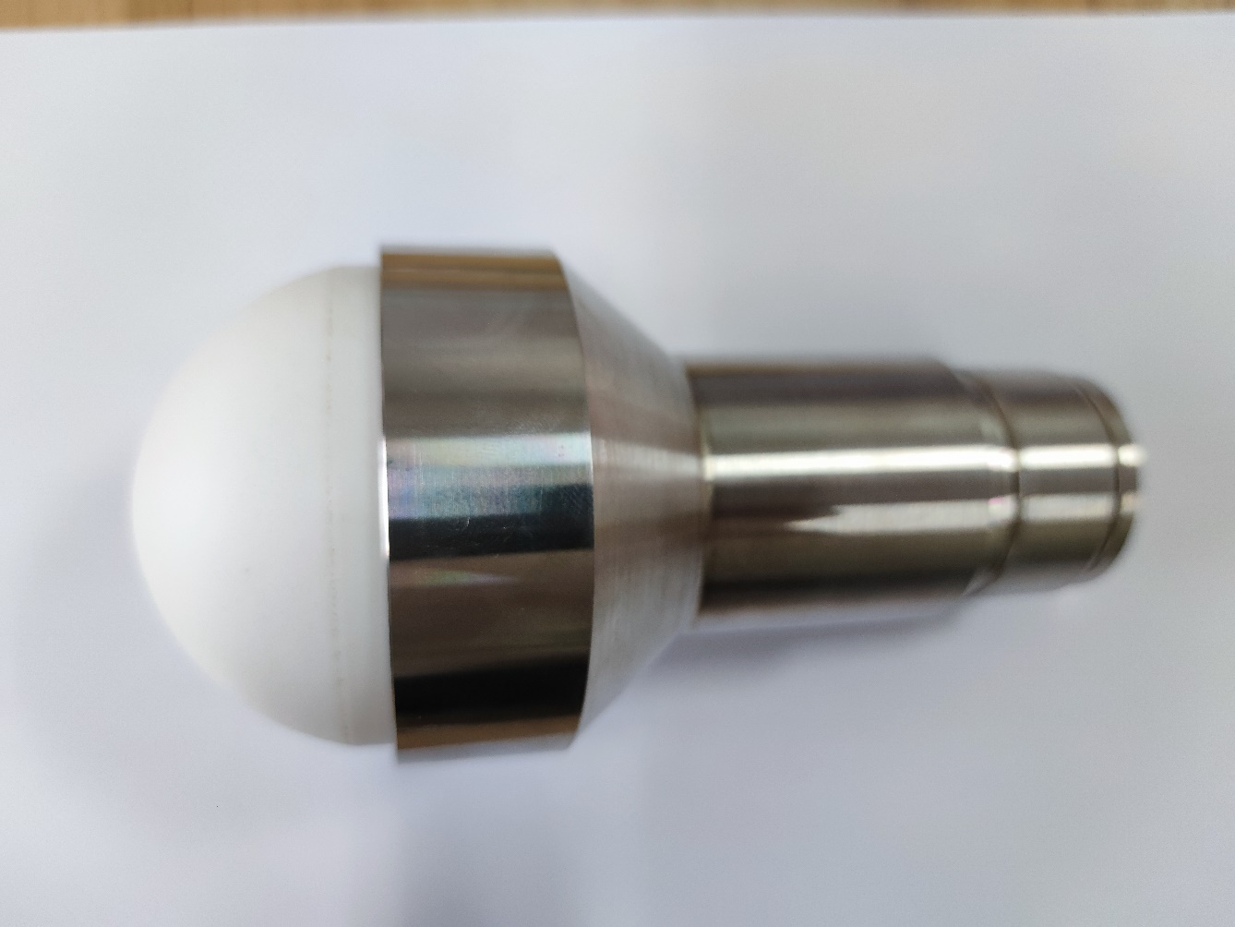
2021 IEEE 4th International Conference on Electronic
Information and Communication Technology
Design of mm-Wave Dielectric Lens Antenna for Liquid Level Gauge Radar
ChaoJie Guo*, JianZhong Chen, Liang Li, Jia Chen
National Key Laboratory of Science and Technology on Antennas and Microwaves, Xidian University, Xi’an, Shaanxi, China
*E-mail: 18838963933@163.com
INTRODUCTION
ANTENNA STRUCTURE
This paper presents a design of mm-wave dielectric lens antenna for liquid level gauge radar. The antenna consists of a conical horn antenna, a planar convex dielectric lens and an intermediate matching structure. The simulation results show that the lens antenna has ideal gain and beam width, this feature can be further improved by changing the position of the feed. The millimeter-wave dielectric lens antenna designed for level gauge radar has a lens diameter of 73.1mm, a beam width of 3.7 degrees, and a gain of 31.3dBi, which can well meet the needs of mm-wave radar for narrow viewing Angle and long distance ranging.
Fig.1 Structure of lens antenna
WORKING PRINCIPLE
A. Conical Horn Antenna
B. Front Flat Rear Convex Lens Design
TE11
(1) the basic conical horn antenna
(3)the larger horn diameter
(2) the circular waveguide with the middle matching structure
Fig.2 Conical horn antenna structure diagram
Fig.3 Schematic diagram of front flat and rear convex lens
RESULT
Fig.4 Antenna physical
Fig.5 Lens antenna gain
Fig.6 77GHz pattern of the lens antenna
Fig.7 81GHz pattern of the lens antenna
CONCLUSION
The simulation results show that in the range of 77-81GHz, the maximum gain of the dielectric antenna in the main beam direction can reach 31.3dBi, and the 3dB beam width is 3.7 degrees, which can well achieve long distance ranging.

