Slide 1
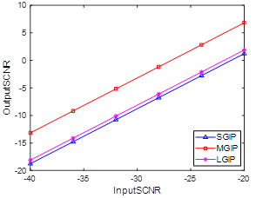
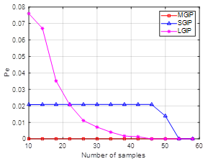
Geometric estimation on manifolds based training data selection
Xixi Chen, Hao Wu, Yongqiang Cheng, and Hongqiang Wang
National University of Defense Technology
INTRODUCTION
SIGNAL MODEL
Clutter suppression performance of STAP will be degraded greatly when using contaminated training data to estimate the clutter covariance matrix. To deal with this problem, a training data selection method based on the geometric estimation on manifolds under the generalized inner product (GIP) criterion is proposed. Exploiting divergences as the geometric metric, an accurate covariance matrix is obtained. Then, combined with the GIP criterion, contaminated training data can be detected successfully. The proposed training data selection method outperforms conventional methods with small sample support, which improves the efficiency of training data selection.
Consider a side-looking airborne radar system with N transmitters and each antenna transmit P coherent pulses. We denote as the training data in the K range cell.
where , , and are the clutter patch, the outlier and Gaussian noise, respectively
Signal Model
THE PROPOSED ALGORITHM AND EXPERIMENTAL RESULTS
Exploit the training data to construct a strictly positive definite matrix in each range cell
(a)
(b)
(c)
The training data selection problem can be viewed as the following binary hypothesis test:
(d)
(e)
(f)
Fig. 1. NHD detection results: Figure (a)-(c) are the SGIP, LGIP and the proposed method with 10 training samples; Figure (d)-(e) are the SGIP, LGIP and the proposed method with 60 training samples.
One of the divergence (Kullback–Leibler) is exploited as the geometric metric, which can be obtained by:
The decision rule of the above test is
(d)
Fig. 2.Output SCNR against input SCNR
Fig. 3. Probability of false detection concerning the number of samples
CONCLUSIONS
In this paper, a training data selection method based on geometric estimation is proposed. Experimental results show the effectiveness of the proposed method. This work can be useful for the application of STAP in heterogeneous environments.

