Slide 1
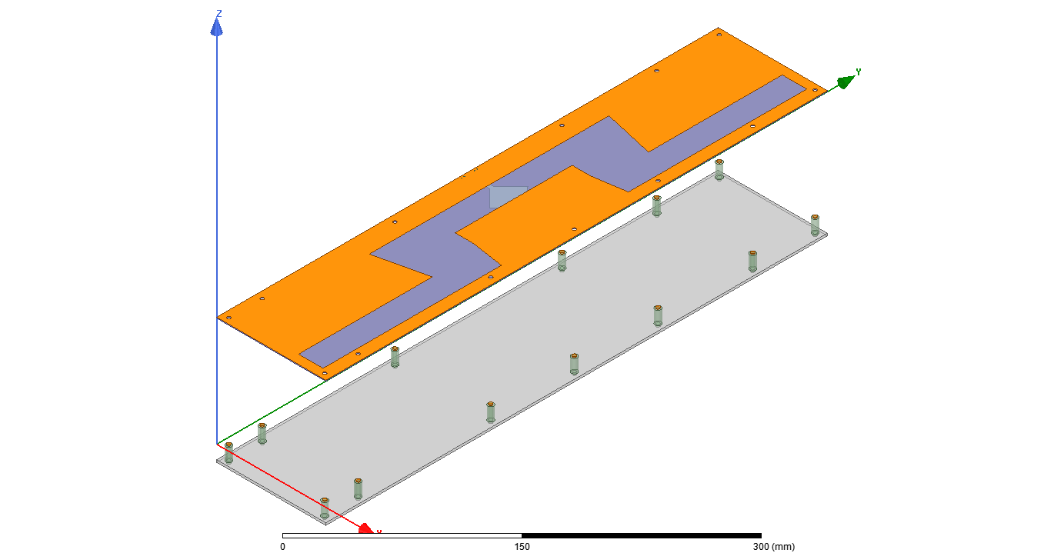
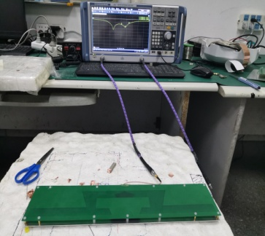
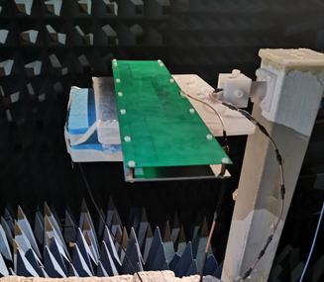
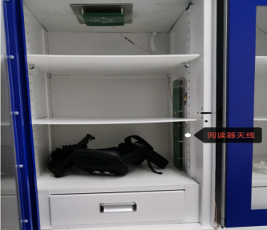
A Slot-based RFID Reader Antenna Design with Broad Left to Right Space Detections
Jun Shen, Yanru Fang, Linghui Kong, Xueguan Liu
Soochow University , Suzhou, China
Abstract
In this paper, a low profile antenna for radio frequency identification devices (RFID) reader is proposed with the thickness of 15 mm and length of 450 mm. The antenna prototype is designed by etching a slot on the FR4 board supported by an alumina plate. Electromagnetic radiations will be generated within by the slot with a broad left to right spatial detection areas. Simulated and measured results show a good agreement on the working band from 886 MHz to 918 MHz, and far field radiation patterns with a maximal gain of 0 dBi. The tested results also satisfy with the practical requirements for applications.
Antenna Structure
The complete antenna structure is shown in Fig. 1, consisting of the top radiation layer and the ground reflector. The radiation element is a slot antenna fabricated on FR4 substrate with thickness of 0.8 mm. The slot antenna is fed by microstrip line located at the bottom layer of substrate to generate radiations. An aluminum plate is placed 12mm under the FR4 substrate and used as the reflector to maintain the upper half space radiations. The radiation element and ground plate are connected by eight copper and five plastic pillars. The copper pillars are placed on the antenna end while the plastic pillars in the middle. All these 13 pillars have the same dimensions with the diameter of 3.0 mm and the height of 12.0 mm.
Test Result
The return loss is measured with ROHDE&SCHWARZ ZND vector network analyzer, it shows that the simulated and measured results agree well with the return loss below -10.0 dB in the in the working band. The radiation performances are also shown in Figs in black color, it can be seen that the beam keeps a narrow angle at XoZ plane, while a wide angle from back to the front at YoZ plane. It indicates that RF tags can be effectively detected when passing through the reader antenna.
To further evaluate the performance of the proposed antenna, the fabricated antenna prototype is used as the reader inside a locker to detect and track the items attached with RF tags. The results show a high reading efficiency of 100% percentages.
Conclusion
This paper proposed a new slot-based RFID reader antenna to detect the passing RF tags passing through. Radiations can be generated by the slot with a wide left to right detecting area to satisfy the practical requirements. This antenna has a good impedance match over the operating frequency band and electric field distribution in the recognition area. Measured results show a good match with the simulations. Compared with other reader antennas, this antenna performs a good detecting efficiency within the special requirements as the far field reader.

