Slide 1
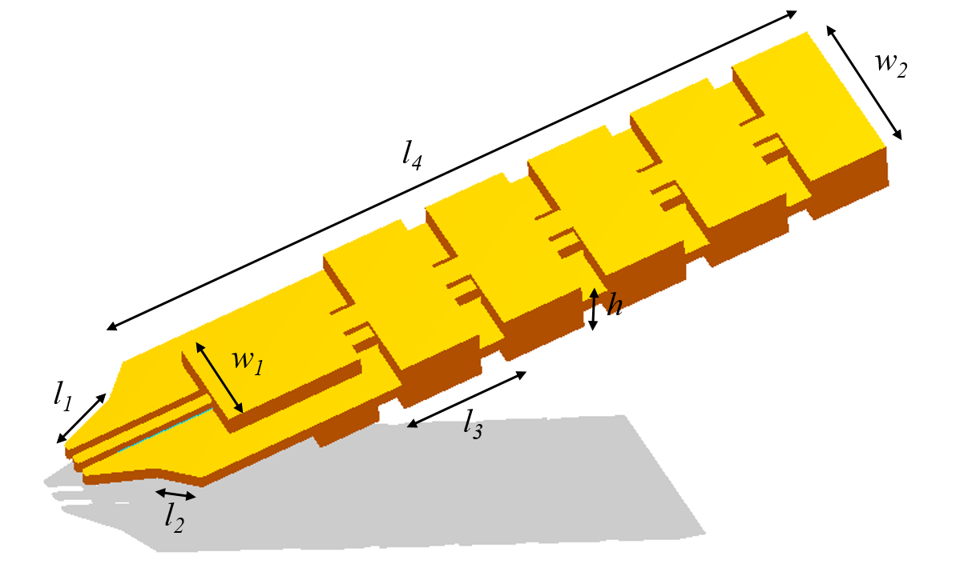
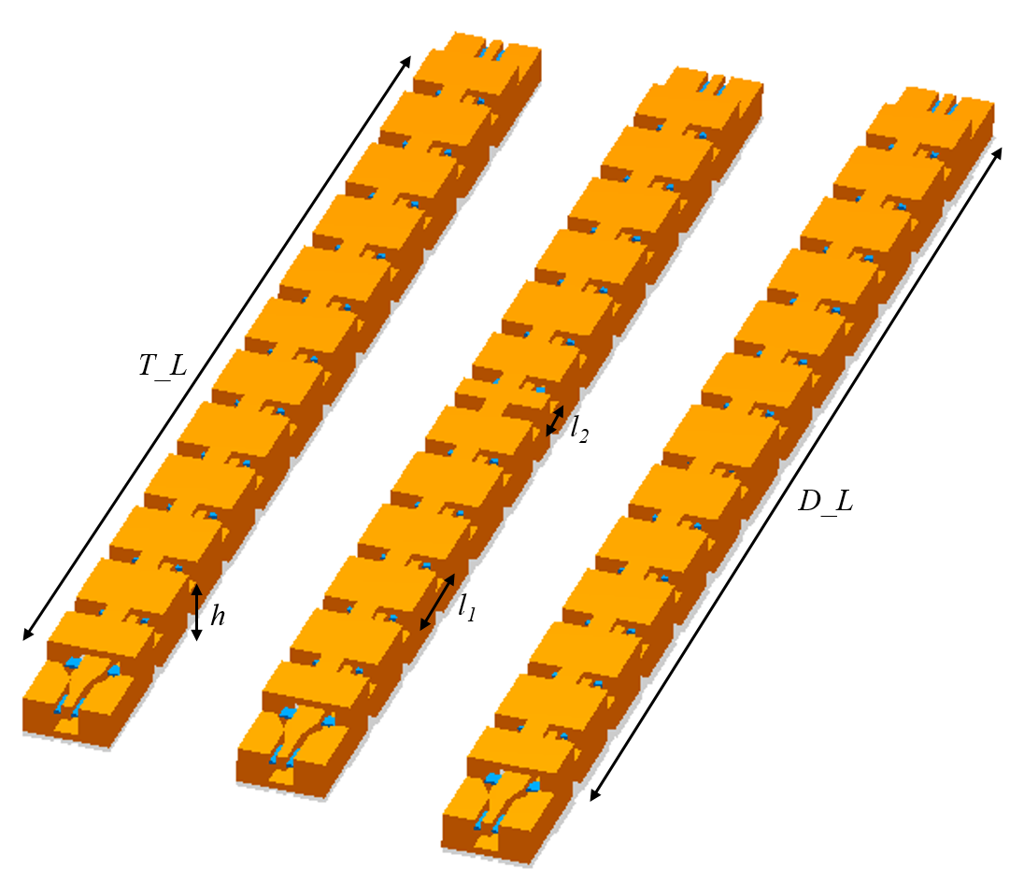
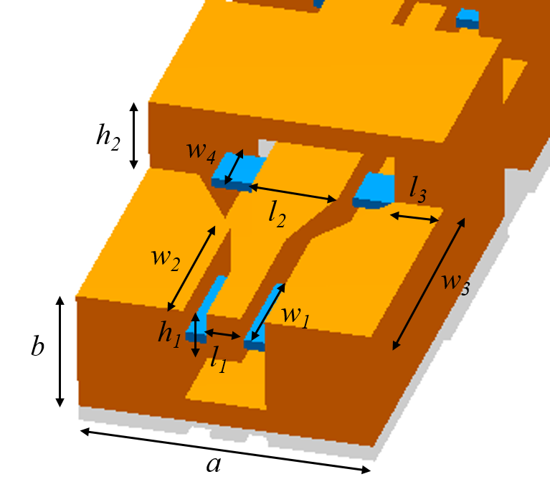
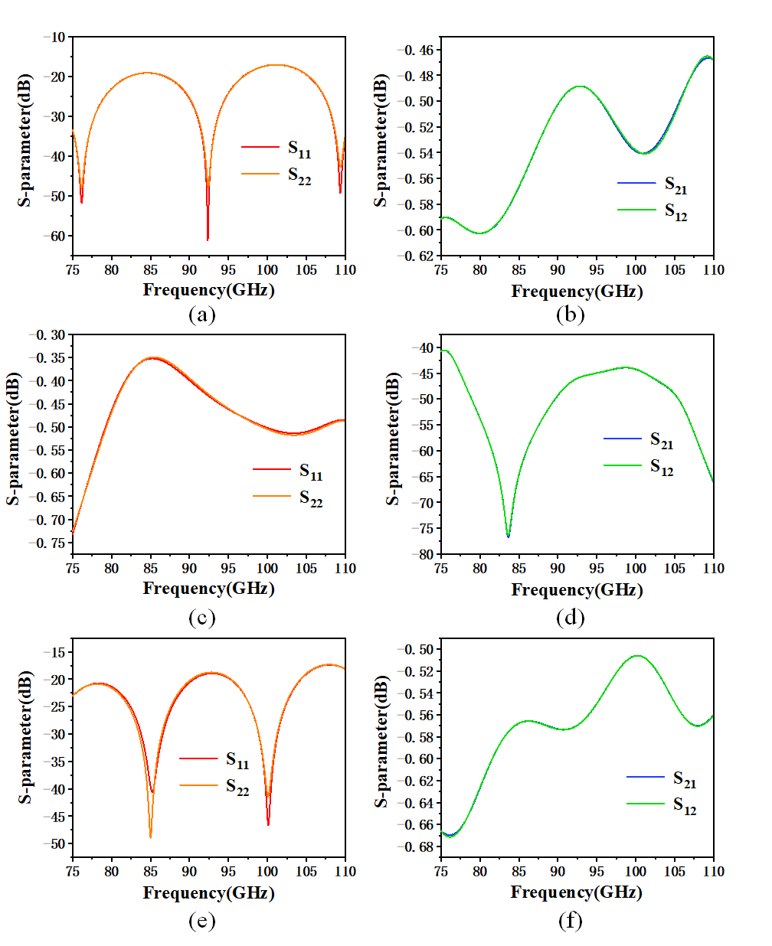
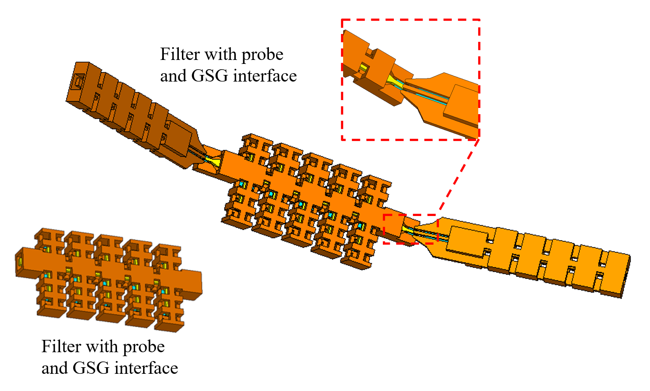
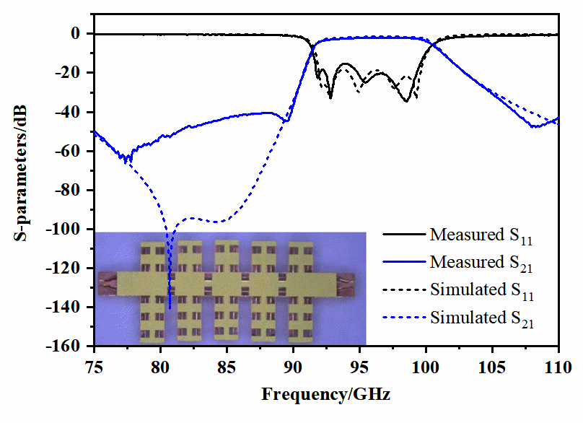
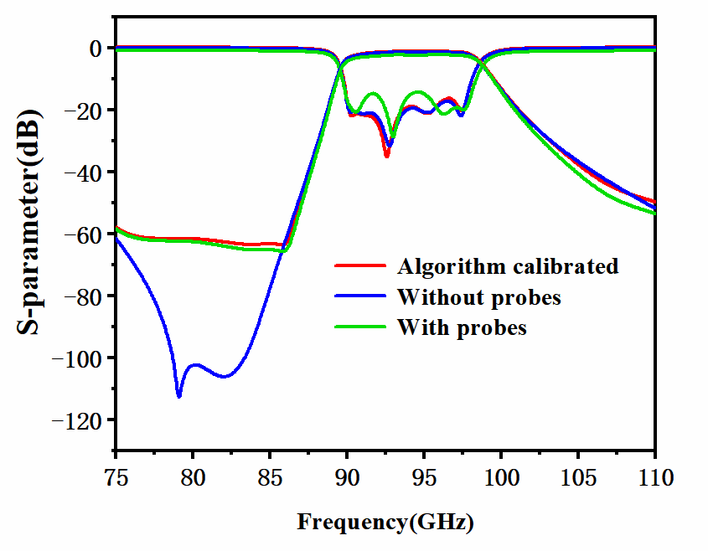
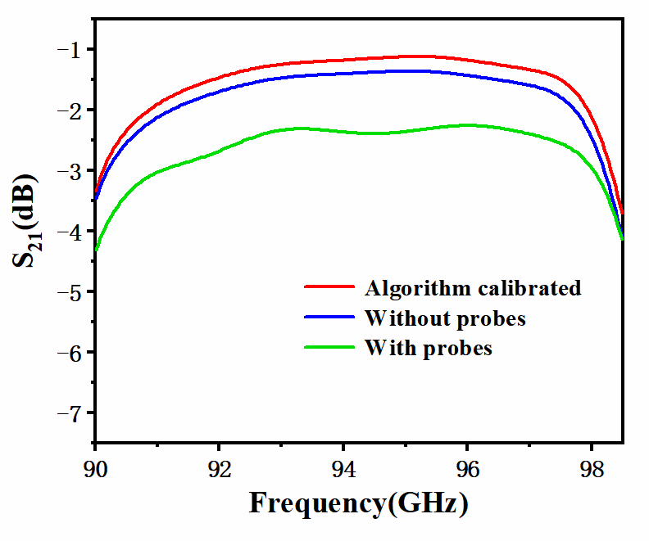
Simulation on the TRL Calibration of a MEMS Filter using MEMS Micro-coaxial Probe
Wenxuan Wu
School of Information and Communications Engineering
Xi'an Jiaotong University
Minjie Shu
School of Information and Communications Engineering
Xi'an Jiaotong University
Guanghua Shi
Hebei Semiconductor Research Institute
Xi'an Jiaotong University
Wenjiang Wang
School of Electronic Science and Engineering
Xi'an Jiaotong University
Zixian Wu
School of Information and Communications Engineering
Xi'an Jiaotong University
Cheng Guo
School of Information and Communications Engineering
Xi'an Jiaotong University
ABSTRCET
In this paper, an on-wafer S-parameter calibration method and a complete set of TRL calibration kits is presented. Both the calibration kits as well as the micro coaxial probes were designed based on a MEMS process. An eight-term error model is used to do the calibration and the calibration process was performed using the EM full wave simulation software. Moreover, we design these calibration kits and the micro-coaxial probes in order to verify some experimental results from our previous work, that the crossover effect between the probes as well as the surface wave degraded the measured rejection of a W band MEMS filter. As a result, the simulation results fit the measured result well, demonstrating the validity of the probes and the kits design, future work can be delegated to the design of more sophisticated calibration kits and algorithms to alleviate the aforementioned problems.
ARCHITECTURE AND DESIGN
(a) (b) (c) (d)
Figure 1. (a) Cross section views of micro coaxial line. (b) The picture of the GSG probe. (c) The picture of the calibration kits. (d) The detailed size of the interface.
A. Architecture and design of probes
The tip of the MMW probe is designed according to the size of the filter’s GSG interface, and the distance between the ground and the signal line is 100μm. l₁=0.42mm, l₂=0.28mm, l₃=0.7mm, l₄=4.7mm, w₁=0.6mm, w₂=1mm, h=0.4mm. B. Architecture and design of on-wafer calibration kits
The configurations of the proposed TRL kits are shown in Fig. 1(c). The guide wave structure of the through, short and 1/4λ delay line are designed same as the probe. T_L=8mm, D_L=8.806mm, l₁=0.7mm, l₂=0.2mm, h=0.4mm. h₂=0.15mm, b=0.25mm, w₁=0.22mm, w₂=0.325mm, w₃=0.5mm, w₄=0.1mm, a=0.6mm, l₁=0.07mm, l₂=0.178mm, l₃=0.1mm.
Figure 2. The S-parameter curves of each calibration kits. (a)(b)through; (c)(d)shorted circuit; (e)(f)1/4λ delay line.
SIMULATION RESULTS AND DATA ANALYSIS
(a) (b) (c) (d)
Figure 3. (a) Filter with and without probe and GSG interface. (b) Schematic diagram of micro coaxial structure. Simulated and measured results of coaxial bandpass filter. (c) Comparison of algorithm calibrated results, results without probes and without probes. (d) Details of the insertion loss in the passband.
In this work, an on-wafer MEMS probe and its TRL calibration kits are designed and used to calibrate a W band MEMS filter in the simulation software. The simulation results fits our measured results well: The out-of-band performance of the filter was degraded by the crosstalk of the probes. In future works, new calibration kits and algorithms can be designed to alleviate these problems.

