Slide 1

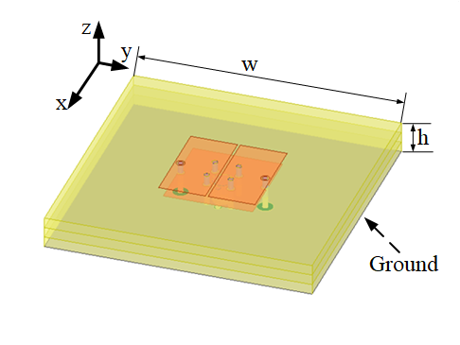
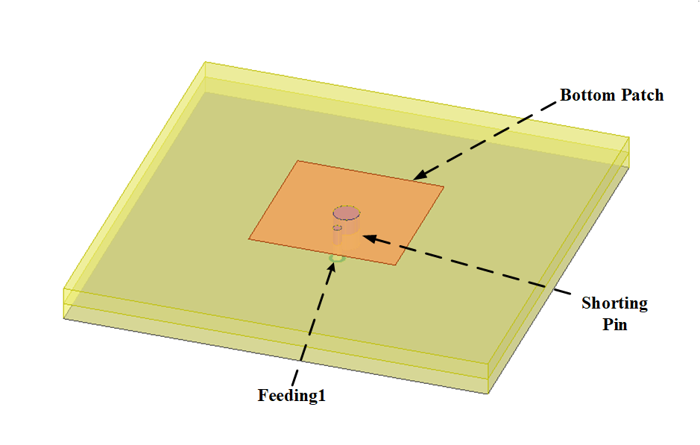
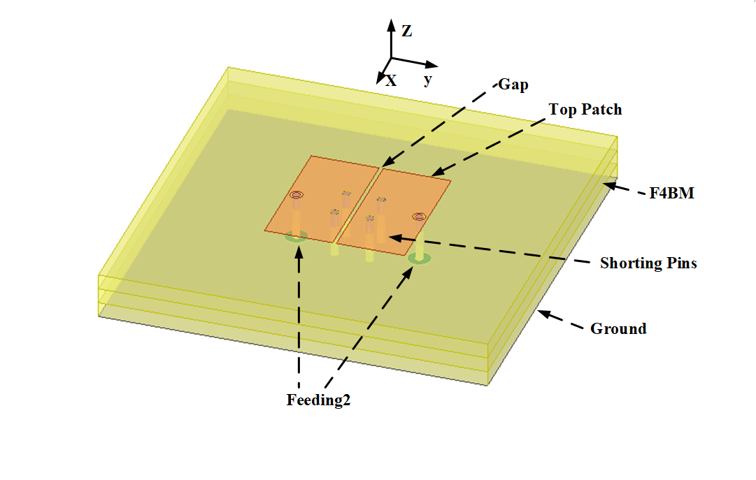
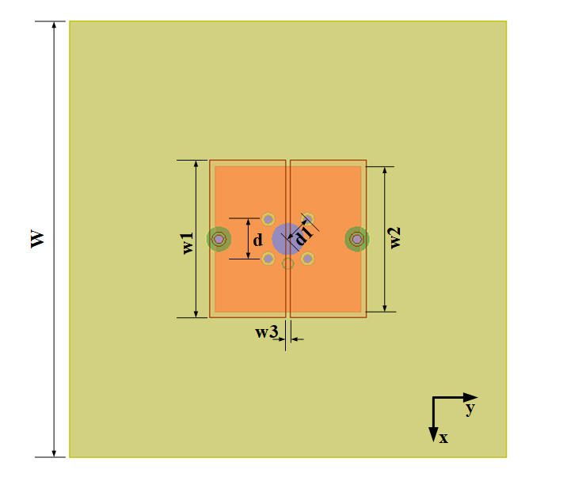
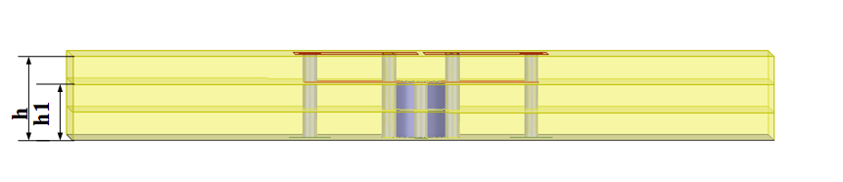
A Novel Miniaturized Mutil-Mode Pattern Diversity Antenna for Wearable Wireless Communications
Xiuqing Geng*, Zehong Yan, Xiyu Wang, Dandan Yang
National Key Laboratory of Science and Technology on Antennas and Microwaves, Xidian University, Xi’an, Shaanxi, China
*E-mail: gengxiuqing@163.com
Abstract—A novel miniaturized, multi-mode, pattern diversity antenna for wearable wireless body area networks is proposed. The antenna uses even-modes to provide directional and omnidirectional radiation patterns, which can realize the miniaturization of the antenna. The omnidirectional radiation pattern is obtained by introducing a probe to excite TM01 mode. The directional mode is realized by exciting the first negative order resonance (-1st mode) based on compound right-/left- hand (CRLH). Compared with the traditional patch antenna, the -1st mode works in the LH region, which is much lower than the +1st mode resonance. These CRLH resonators are realized by etching the gap on the surface of the chip and introducing short-circuit pins. The CRLH circuit consists of series and parallel inductors and capacitors provided by the above mentioned constitute. In addition, the antenna has simple structure and low profile. It only consists of patch, pins and thin metal ground, which is easy to process. Finally, the two antennas are integrated together to achieve pattern diversity, effectively save space and realize the miniaturization of the antenna. Its overall size is only 0.41λ₀×0.41λ₀×0.049λ₀.
The resonant frequency and impedance bandwidth can be changed by changing the values of the parallel inductor and the series capacitor, that is, the gap size and the number of pins. After removing the gap on the top patch, the π-type unit is destroyed and the -1st mode disappears.
Ⅱ. SIMULATION RESULTS
Fig. 3. The S parameters of the antenna for -1st mode and 0th mode.
Ⅰ. Antenna Analysis and Design
The configuration structure of the proposed antenna is shown in Fig. 1. The rectangular patch in the middle is designed to work in TM₀₁ mode and has an omnidirectional radiation pattern for on-body communication.
Fig. 4. The normalized radiation pattern of 0th resonance mode on (a) xoz plane and (b) xoy plane.
(a)
Fig. 5. The normalized radiation pattern of -1st resonance mode on (a) H-plane (xoz plane) and (b) E-plane (yoz plane).
Fig. 3. provides the S parameters of the antenna in -1st resonance mode and 0th resonance mode. It can be seen from the figure that the S11 of the -1st mode antenna at the 2.47 GHz are below -25dB. At the on-body mode, the is below -10 dB at the frequency range from 2.44 GHz to 2.48 GHz.
The normalized radiation pattern of 0th mode is shown in Fig. 4. It can be seen that the antenna provides the omnidirectional radiation pattern on the xoy and xoz planes.
Fig. 5. shows the radiation pattern of the antenna fed by the port2 on the xoz and yoz planes. It can be seen that the antenna provides a directional radiation pattern.
(b)
(c)
(c)
Fig. 1. The geometry of the proposed antenna based on the CRLH structure. (a) Perspective view. (b) Configuration of the 0th-order mode. (c) Configuration of the -1st-order mode.
Ⅲ. Conclusions
(a)
(b)
A multi-mode pattern diversity antenna is presented in this paper. Firstly, the even-mode is used to realize the directional and omnidirectional radiation pattern, and the -1st order mode based on CRLH is used to realize the lower profile. Secondly, the directional and omnidirectional radiation modes are integrated into one antenna to achieve pattern diversity and improve space utilization. The results show that the proposed antenna can provide a miniaturized multi-mode pattern diversity antenna with miniaturization, which provides a good choice for WBAN applications.
Fig. 2. (a) Top view. (b) Side view.
The geometric structure of the proposed CRLH resonator is shown in Fig. 2 (a) and (b). In Fig. 2 (a), a gap with width of w1 is etched in the middle of the patch, which is used as a series LH capacitor. Fig. 2(b) metal pins are used as the LH parallel inductor between the patch and the ground plane, and the patch itself provides a RH parallel capacitor and a RH series inductor, a π-type unit can be obtained to excite the -1st mode.
References
[1]K. Ito, “Compact dual-mode antenna for body-centric wireless communications,” 2015 9th European Conference on Antennas and Propagation (EuCAP), pp. 1-2, 2015.
[2]H. Sun, Y. Hu, R. Ren, L. Zhao and F. Li, “Design of pattern-reconfigurable wearable antennas for body-centric communications,” in IEEE Antennas and Wireless Propagation Letters, vol. 19, no. 8, pp. 1385-1389, Aug. 2020.
[3]Z. G. Liu and Y. X. Guo, “Compact low-profile dual band metamaterial antenna for body centric communications,” IEEE Antennas Wireless Propag. Lett., vol. 14, pp. 863–866, 2015.
[4]Y. Sharma, D. Sarkar, K. Saurav, and K. V. Srivastava, “Three-element MIMO antenna system with pattern and polarization diversity for WLAN applications,” IEEE Antennas Wireless Propag. Lett., vol. 16, pp. 1163–1166, 2017.
[5]S. Yan and G. A. E. Vandenbosch, “Wearable antenna with tripolarisation diversity for WBAN communications,” Electron. Lett., vol. 52, no. 7, pp. 500–502, 2016.
[6]S. Yan and G. A. E. Vandenbosch, “Radiation pattern-reconfigurable wearable antenna based on metamaterial structure,” in IEEE Antennas and Wireless Propag. Lett., vol. 15, pp. 1715-1718, 2016.
[7]Y. Dong and T. Itoh, “Metamaterial-based antennas,” Proc. IEEE, vol. 100, no. 7, pp. 2271–2285, Jul. 2012.
[8]Z. Wang and Y. Dong, “Miniaturized RFID reader antennas based on CRLH negative order resonance,” IEEE Transactions on Antennas and Propagation, vol. 68, no. 2, pp. 683-696, Feb. 2020.

