Slide 1
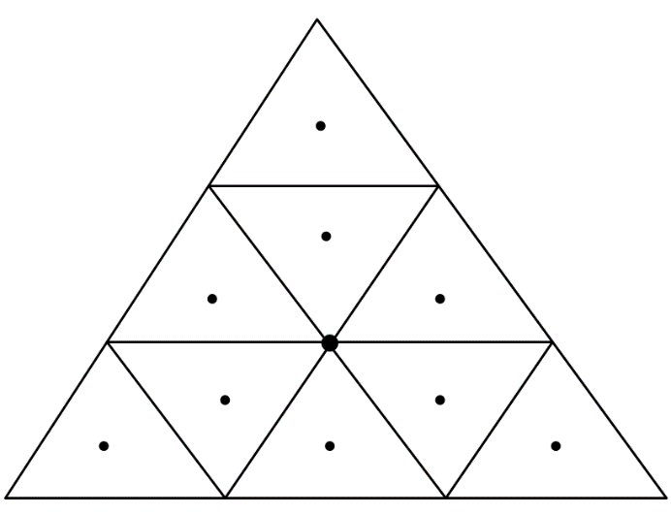
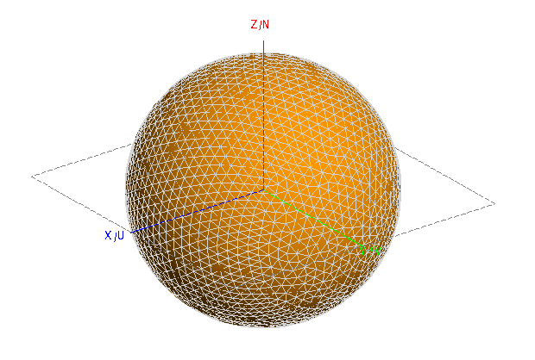
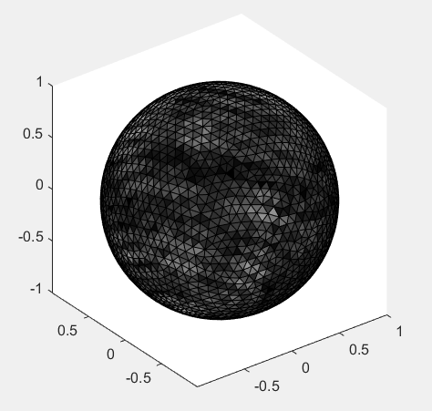
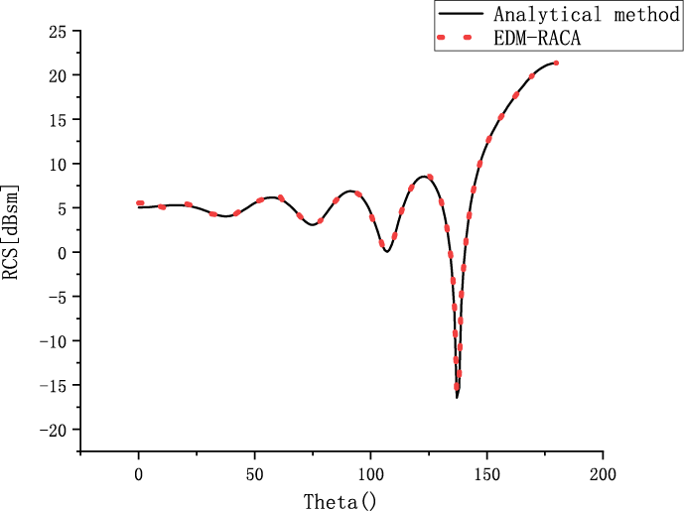
Fast Filling Algorithm of EDM-RACA Matrix Based on Centroid Segmentation Moment Method
Jianning Zhang
Yun Wang
Guangyu Zhang
Junyan Wang
Qiuming AI
Yaxiu Sun
2021 ICEICT
Motivation
Problem solution
Fast algorithm
1. Singularity problem
In the process of using the method of moments to calculate electromagnetic conductors, there will be singularities due to the Green's function.
When using the method of moments of computational electromagnetics to solve problems, you must first select basis function, as shown in the figure, the RWG basis function is selected in this article, which can effectively simulate any object.
In this article, a fast algorithm is used to speed up the above calculation results. The effect is to reduce unnecessary calculations in the process of filling the matrix, and use approximate fitting to replace the original accurate analytical solution, also known as Adaptive cross approximation algorithm:
2. Computational complexity
When using the method of moments to calculate electromagnetic conductors, it is difficult to calculate electrically large conductors due to the wavelength, and the final calculation time and memory usage are very large.
This algorithm solves the dense problem of the matrix through mathematical principles. The improved RACA algorithm is given below
Problem Formulation
When using this method, singularity problems will arise due to the above equations.The singularity problem is solved by using the method of centroid cutting. The schematic diagram is as follows:
Results
1. How to solve the singularity problem ?
The figure on the right is a calculation example of an ideal conductor ball, here is its modeling and surface current model, and the final calculation results
By using the RWG basis function method, we propose to use the centroid segmentation method based on mathematical methods and the original matrix calculation equation has been changed
On this basis, when the distance between the observation point and the source point is greater than 0.15 wavelengths, we use the equivalent dipole model to further accelerate the calculation of the matrix.
2. How to reduce the amount of calculation ?
By using the equivalent dipole moment method (EDM), a new algorithm is further used to reduce the calculation time
The display form of the matrix becomes:

