Slide 1



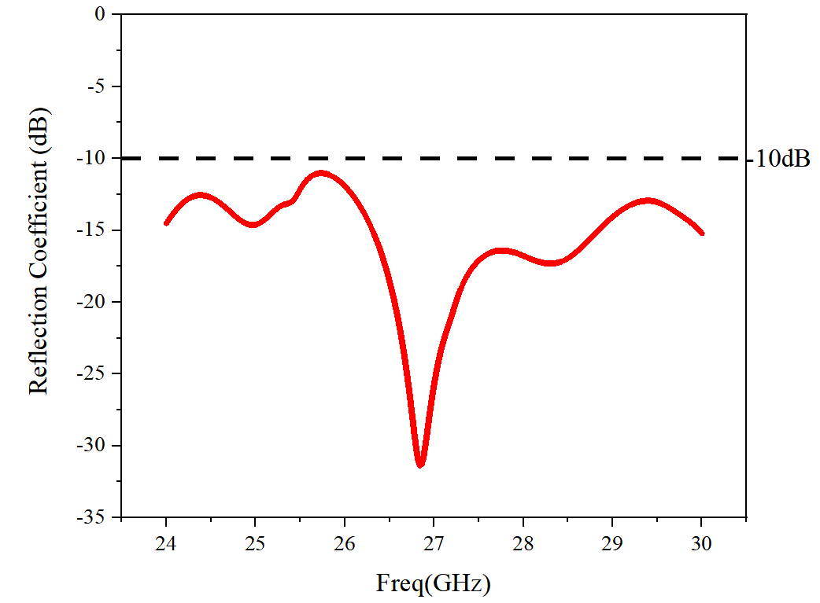
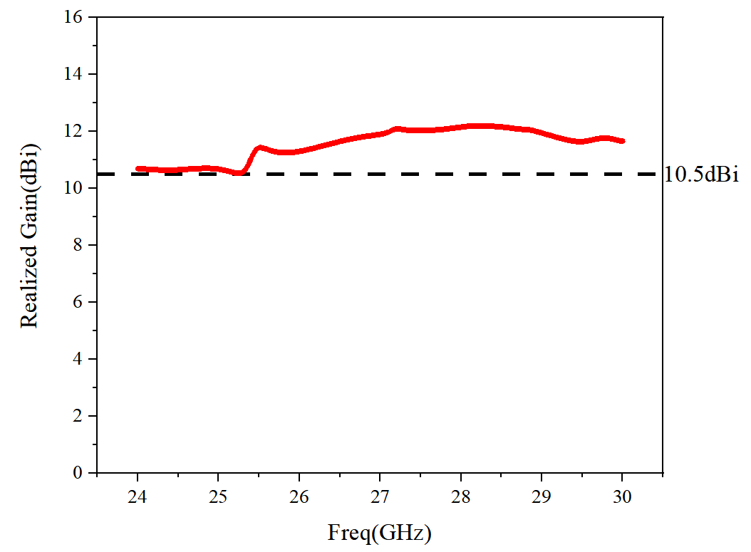
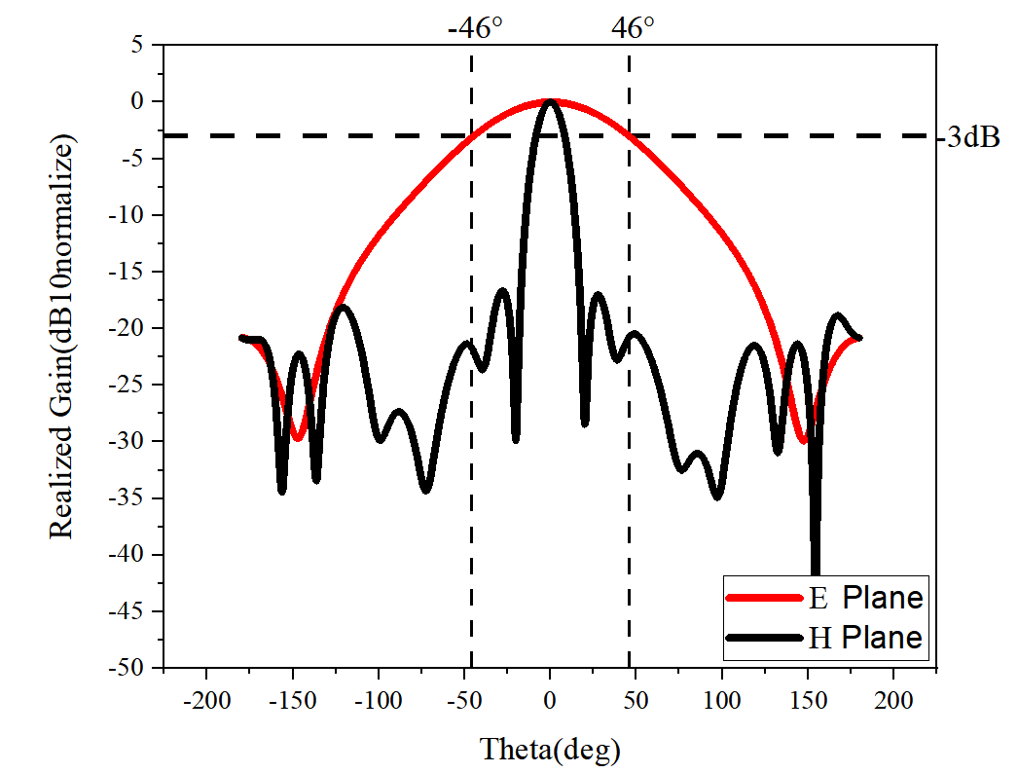
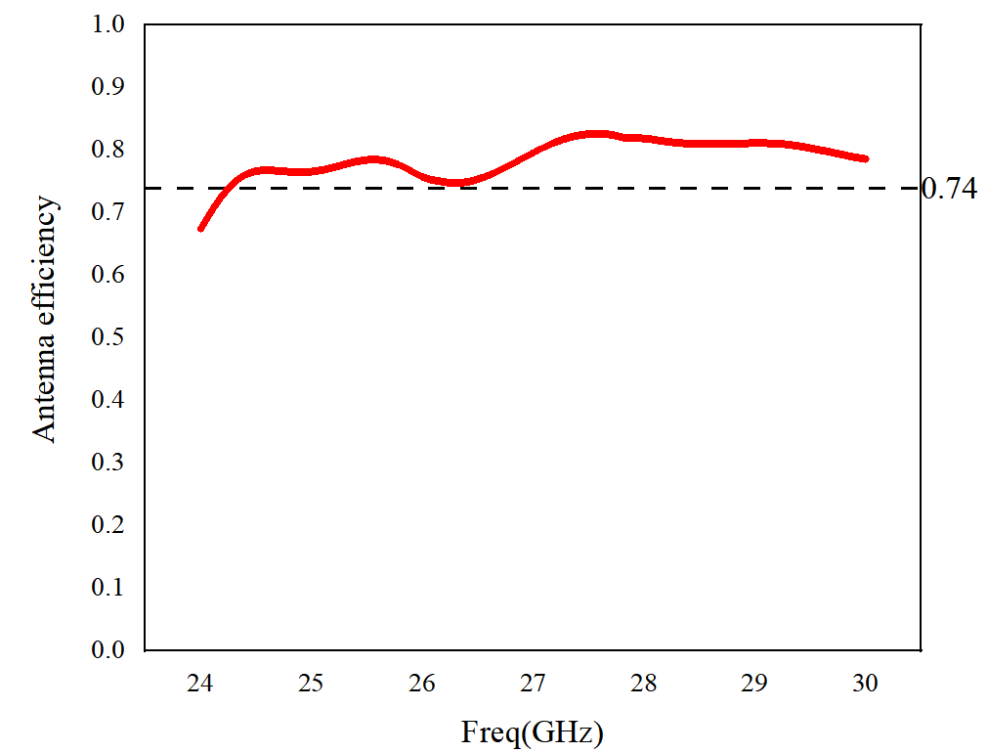
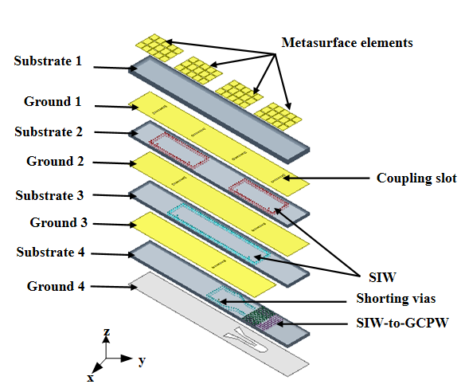
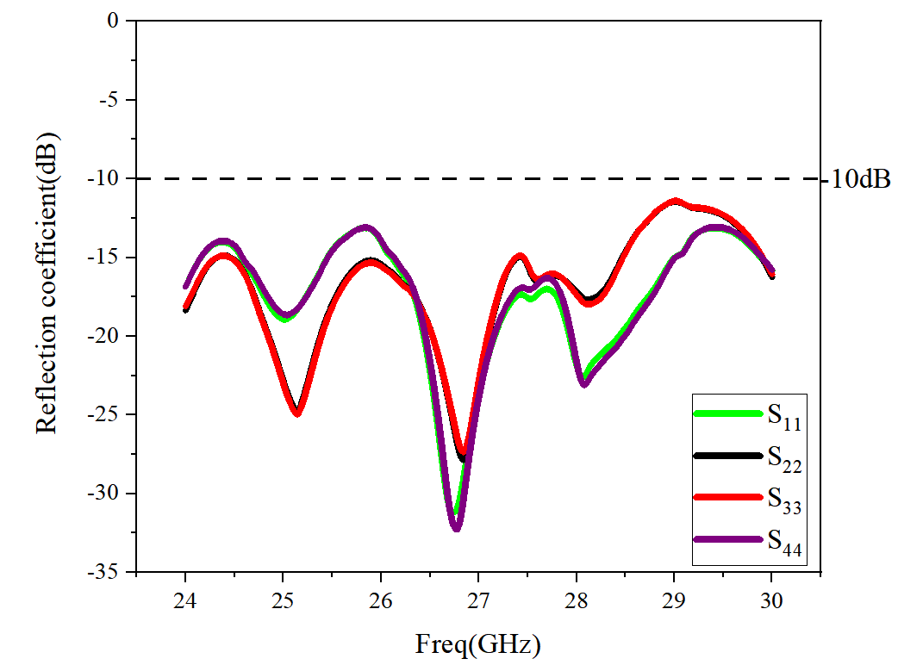
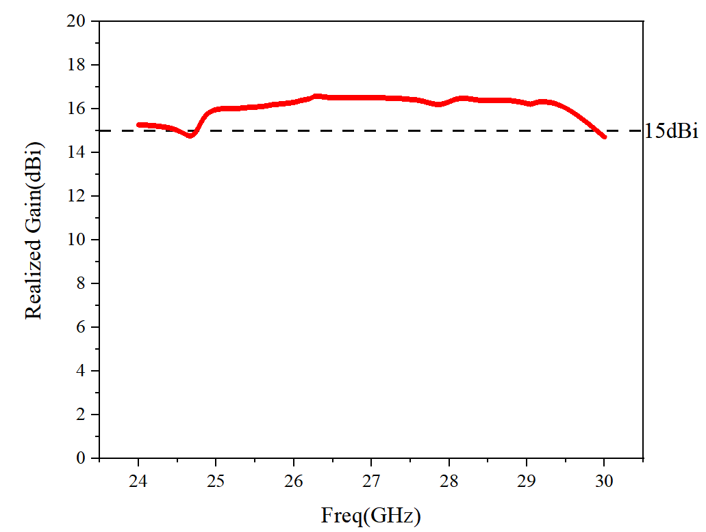
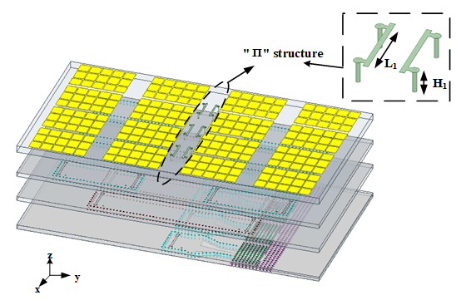
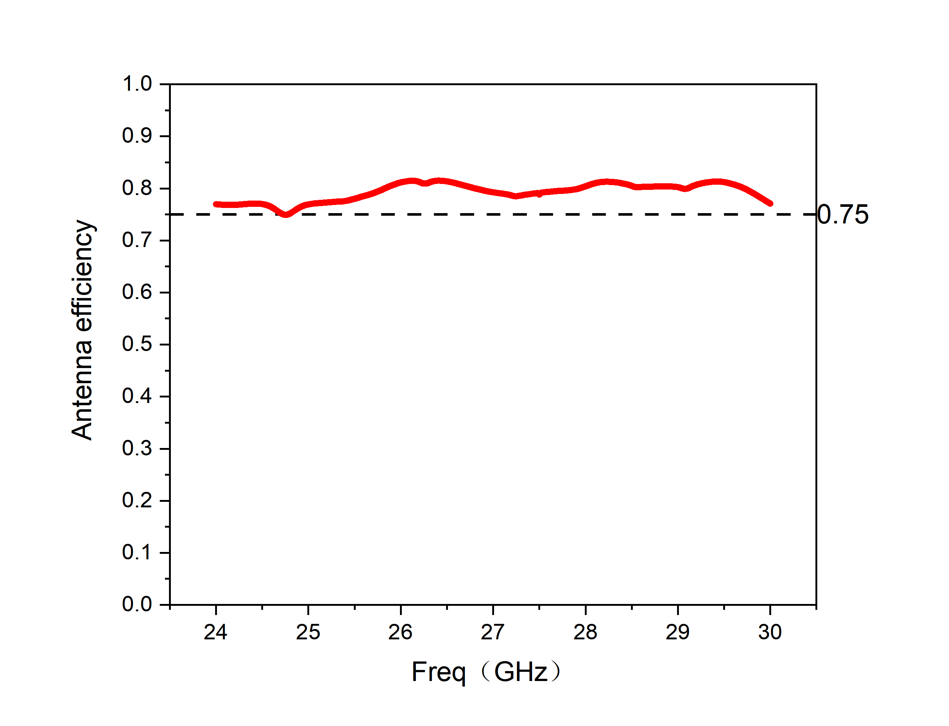
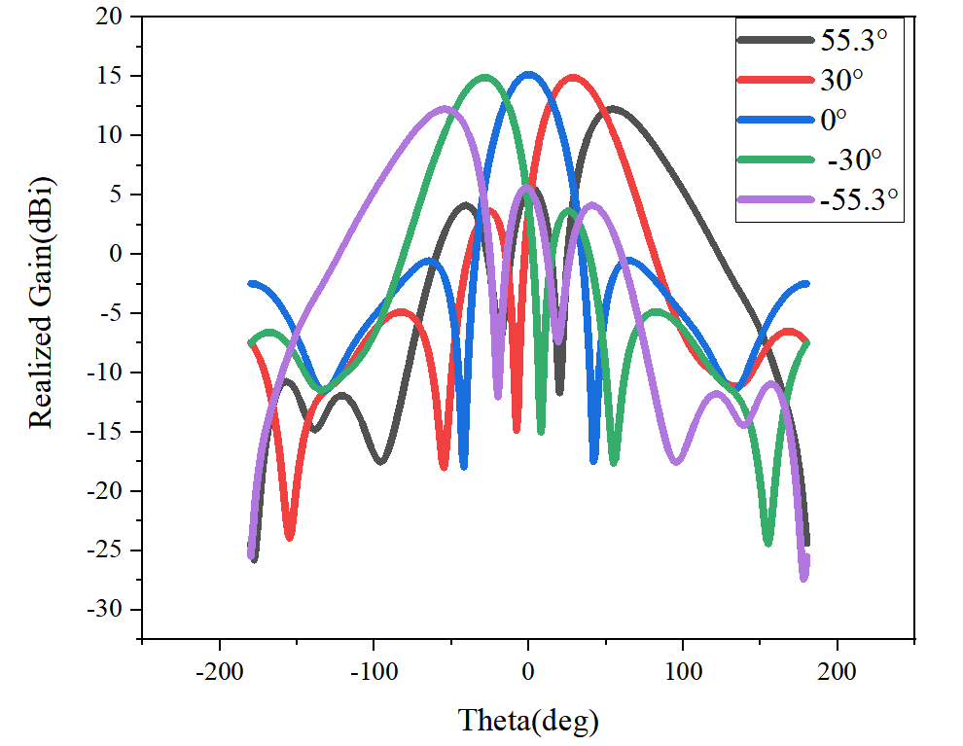
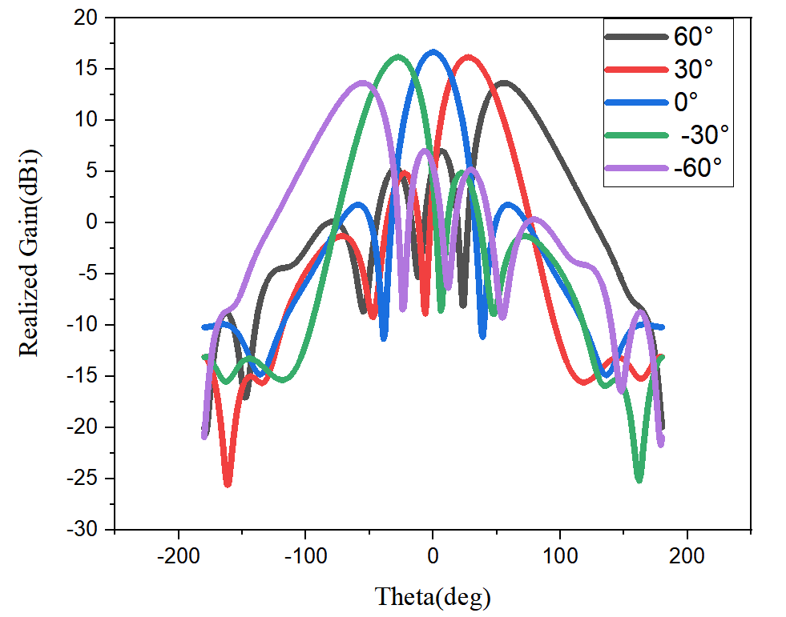
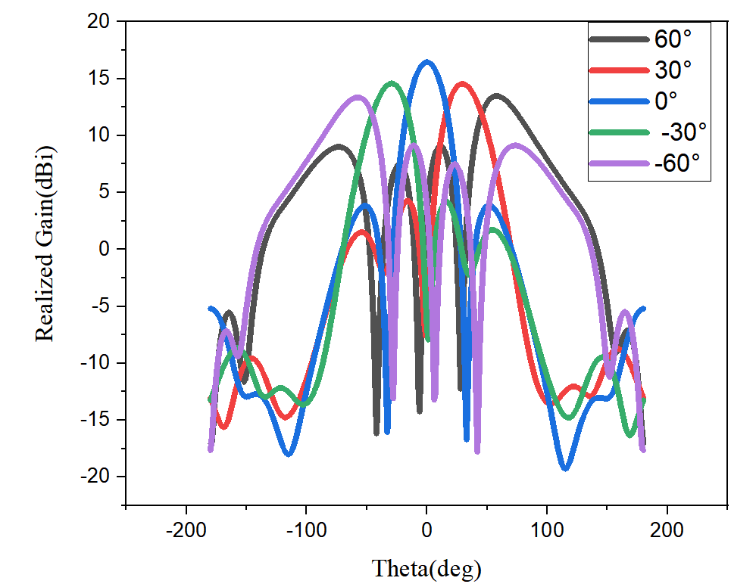
Millimeter-Wave Wideband Wide-Angle Scanning Phased Array Based on Metasurface for 5G Applications
Jin Xiao^{1,2,3}, Shaowei Liao^{1,2,3}, Quan Xue^{1,2,3}, Wenquan Che^{1,2,3}
¹School of Electronic and Information Engineering, South China University of Technology, Guangzhou, China
² Guangdong Provincial Key Laboratory of Millimeter-wave and Terahertz, South China University of Technology, Guangzhou, China
³Guangdong Artificial Intelligence and Digital Economy Laboratory (Guangzhou), Guangzhou , China
1066133572@qq.com
Introduction
  D. Data Analysis of 1×4-element subarray
Methods for improving the scanning performance
  non-periodic metasurface
  Π-shaped structure
This work analyzes a novel mmW wideband wide-angle scanning phased array. A new antenna element based on metasurface is designed, forming a 1×4-element subarray. The 10-dB impedance bandwidth of the subarray is over 20%. Based on the subarray, a 4×4-element planar phased array is implemented, whose scanning range reaches ±55° with a gain fluctuation less than 3 dB over the whole 5G mmW band (24.25-29.5GHz).
(a)
(b)
Simulation and data processing
  A. 1×4-ELEMENT SUBARRAY
(c)
(d)
Fig.1. Simulation data of the subarray: (a) reflection coefficient,(b) realized gain,(c) radiation patterns at 29.5GHz,(d) efficiency.
The realized gain of the subarray is over 10.5 dBi in the whole band(20%) with good gain flatness, and the maximum realized gain can reach to 12.2 dBi.The efficiency is greater than 74%.
The 3-dB beamwidth on the E-plane is approximately ±46º.
  E. Data Analysis of 4×4-element Wide-Angle Scanning Phased Array
B. 4×4-Element Wide-Angle Scanning Phased Array
(a)
(b)
(c)
(d)
C.Scanning performance comparison with and without Π-shaped structure
Frequency (GHz) | Scanning performance
 | Without Π-shaped structure | With Π-shaped structure
24.25 | 50° | 55°
25.5 | 53° | 56°
26.5 | 51° | 56°
27.5 | 53° | 60°
28.5 | 57° | 60°
29.5 | 57° | 60°
(e)
(f)
Fig.2. Simulation data of the subarray: (a) reflection coefficient,(b) realized gain,(c) efficiency, scanning performance at different frequencies: (d)25GHz, (d) 27.5GHz, (f) 29.5GHz.
Conclusion
The scanning angle of the array is over ±55º at all the frequencies with a gain fluctuation less than 3 dB. And it can reach the scanning angle of ±60º at high frequencies.
Loading this structure increases the scanning angle by more than 3º on average, and it can increase by 7º at the maximum.
Notes:
Introduction
Good morning! The title of my poster is Analysis and comparison of window functions based on arch measurement system. The poster consists of three parts. First, I will introduce some backgrounds about the poster, a number of measurement methods are recommended to measure the reflectivity of absorbing materials according to the IEEE standards. For example, arch method, Time-domain measurement approach and so on, and the arch method which is invented by the Naval Research Laboratory is the most widely used measurement method among them. In the arch method, there are two main factors that affect the measurement results, and they are sample dimension and coupling energy. In this work, we analyzed the method of removing interference and applied a variety of commonly used window functions to process the simulated data.
simulation and data processing
The second part is about simulation and data processing and fig.1 shows the schematic diagram of the arch method.
A
First, the principle of data processing is shown in fig.2, we will record three sets of data in frequency domain, and they are Gama_{SUT}, Gama_{pec}, Gama_{empty}, and then transform them into the time domain by using IFFT, we can see that the reflected signals from sample and directly coupled signals have different time duration, so we can remove the coupled signals by adding a suitable window function in time domain, then, we should reconvert the signals into frequency domain to calculate the reflectivity.
B
Part B is simulation. Fig.3 shows the simulation model in cst and the boundary is set to PML, we can obtain three sets of data by setting the materials to PML, PEC and sample. The result in frequency domain is displayed in fig4.
C
According to the above discussion, we can see Γ_{PEC} is the largest, Γ_{SUT} is the second, and Γ_{Empty} is the smallest, which is in line with our common sense. In addition, we also see the coupling energy is very large, and the multiple-reflection energy occurs after a period in the first image in fig.5. So, three gates are applied to process the data, and the results shown in the second image, from which we know that the width of the window should be considered carefully for its great influence on the results.
D and conclusion
Another question should be considered is whether the rectangular window function is the most suitable for processing these data. So, five filters are applied to process these data and the results are shown in fig.7, from which we can drive the conclusion: First, we cannot measure the reflectivity of absorbing material without filters in this method. Second, the trends of obtained results are consistent but with some differences, and Butterworth filter and Chebyshev filter-I are recommended to be used in experiment.
That’s all, thank you for your attention.

