Slide 1
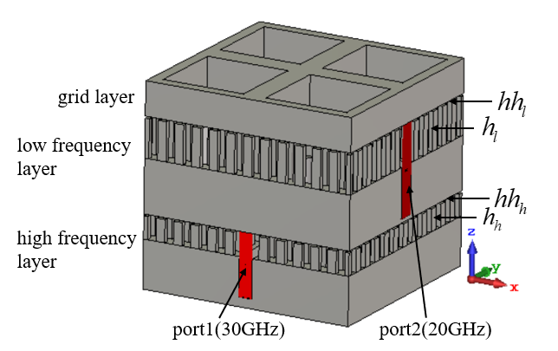
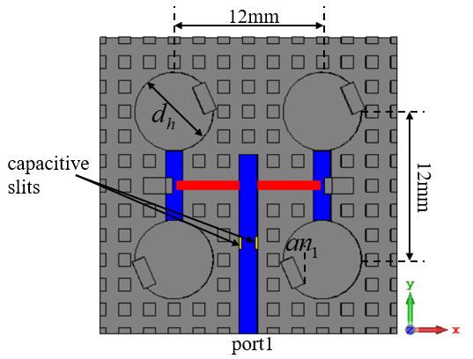
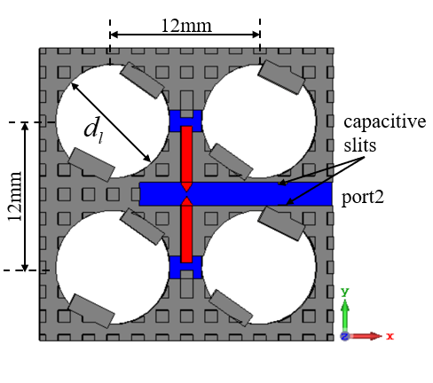
Dual-Circularly Polarized Antenna Array Using Gap Waveguide Technology
Weiyu He, Sifan Wu, Jianxing Li*, Sen Yan, Juan Chen
School of Information and Communications Engineering, Xi’an Jiaotong University, Xi’an, Shaanxi 710049 China
*jianxingli.china@xjtu.edu.cn
ABSTRACT
Ⅲ. SIMULATED RESULTS
In this paper, a dual-band dual-circularly polarized antenna array working at Ka-band and K-band based on gap waveguide (GW) technology is proposed. The antenna is composed of a high frequency layer working at Ka-band, a low frequency layer working at K-band, and a grid layer which lowers the far field side lobe level. The power distribution network is formed by the combination of the groove gap waveguide (GGW) and the ridge gap waveguide (RGW). The energy enters the radiation cavity at the same amplitude and phase though this power distribution network. By placing inclined blocks in the cylindrical radiation cavity, the antenna radiates right-handed circularly polarized (RHCP) waves at high frequency with a gain of 14.5dB and left-handed circularly polarized (LHCP) waves at low frequency with a gain of 13.8dB. The simulation results show that the antenna has a wide impedance bandwidth (27.6GHz-29.74GHz at Ka-band, 17.49GHz-21.81GHz at K-band) and a wide axial ratio (AR) bandwidth (27.5GHz-29GHz at Ka-band, 19.2GHz-20.4GHz at K-band). The proposed antenna has the characteristics of high gain, high efficiency, large power capacity, wide operating frequency band, and no need of interlayer welding.
(a) (b)
Fig. 3. Simulated S-parameter. (a) Ka-band (b) K-band
Ⅰ. INTRODUCTION
In GW technology, artificial magnetic conductor (AMC) structures can be formed by periodic bed-of-nail electromagnetic band gap structures. By controlling the thickness of the air gap, a wide electromagnetic band gap can be formed and energy at frequencies within the band gap cannot propagate. GWs are metallic structures, antenna and microwave devices made of metal have low loss. GWs do not need to be welded in the assembly process, which is good for efficiency. At present, GW technology has been used in the design of antennas, couplers and filters. GW technology can realize single-band circularly polarized antenna, and dual-band linearly polarized antenna.
(a) (b)
Fig. 4. Simulated axial ratio. (a) Ka-band (b) K-band
In Fig. 3, S11 is below -10dB from 27.6GHz to 29.74GHz (FBW=7.46%). S22 is below -10dB from 17.49GHz to 21.81GHz (FBW=19.95%). In Fig. 4, axial ratio is below 3dB from 27.5GHz to 29GHz (FBW=5.31) and 19.2GHz to 20.4GHz (FBW=6.06%).
(a) (b)
Fig. 5. Simulated radiation patterns of Ka-band. (a) φ=0°(b)φ=90°
Fig. 1. 2×2 dual-band dual-circularly polarized antenna array.
Ⅱ. 2×2 ARRAY ANTENNA
Fig. 1 shows the structure of the 2×2 dual-band dual-circularly polarized antenna array.
Fig. 2 shows the top view of the layers of the 2×2 antenna array. Capacitive slits are designed on the inner wall of the GGWs to improve the match (GGWs are shown in blue. RGWs are shown in red. Capacitive slits are shown in yellow). The power distribution network is formed by the combination of GGW and RGW. The energy enters the radiation cavity at the same amplitude and phase though this power distribution network. The top view of the high frequency layer is shown in Fig. 2(a). The radiation cell consists of a cylindrical cavity and an inclined block used to generate a circularly polarized wave, the radiation cell is fed from the side. The diameter of the cylindrical cavity dh=6.4mm. The top view of the low frequency layer is shown in Fig. 2(b). The diameter of the cylindrical cavity dl=9.38m. The high frequency layer is placed in the lower layer for the cylindrical cavity of the high frequency layer with a smaller diameter.
(a) (b)
Fig. 6. Simulated radiation patterns of K-band. (a) φ=0°(b)φ=90°
Fig. 5 shows the antenna radiating right-handed circularly polarized waves at high frequency with a gain of 14.5dB. Fig. 6 shows the antenna radiating left-handed circularly polarized waves at low frequency with a gain of 13.8dB.
Ⅳ. CONCLUSION
A dual-band dual-circularly-polarized antenna array working at K-band and Ka-band based on GW technology is presented. The main work of this paper is 2×2 antenna array, which can be expanded in subsequent work. The proposed antenna can be used in satellite communications. Simulated results demonstrate that the proposed antenna array achieve the excellent characteristics of high gain, high efficiency, large power capacity, wide operating frequency band, and no need of interlayer welding.
Ⅴ. ACKNOWLEDGMENT
This work was supported in part by the Key Research and Development Project of Shaanxi Province under Grant No. 2019GY-007, the National Natural Science Foundation of China under Grant No. 61801369, and the Fundamental Research Funds for the Central Universities.
(a) (b)
Fig. 2. (a) High frequency layer (b) Low frequency layer

