Slide 1
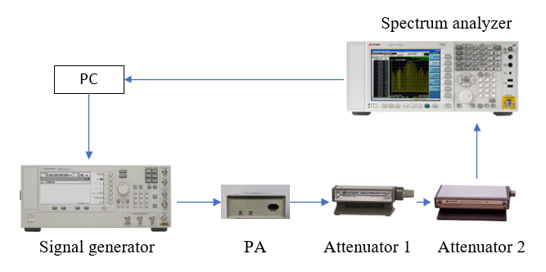
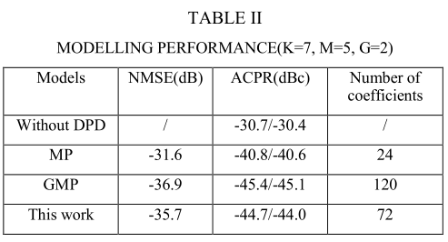
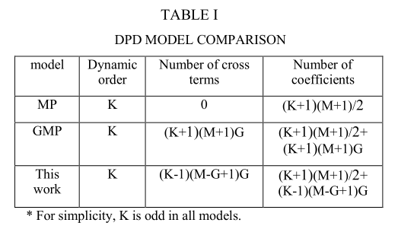
Modified Generalized Memory Polynomial Model of RF Power Amplifiers
Du Chen, Yongjiu Zhao, Yonggang Zhou, Qinmeng Ji, Zehui Chen, Feng Tian
The ICEICT2021 in XiAn, CHINA
Abstract
In this model, we remove non-causal terms and terms with memory depth exceeding M, so that the maximum memory depth of the entire model remains M. Drawing on the idea of dynamic deviation reduction, the form of leading and lagging terms is changed. The dynamic deviation terms in the formula represent the part that has a greater impact on the output.
In this paper, a modified generalized memory polynomial (MGMP) model is proposed for digital predistortion. Using this model to characterize the power amplifier and establish an inverse model can compensate the nonlinear distortion of the power amplifier well. This model changes the form of the envelope terms and deletes some cross terms, which reduces the number of coefficients greatly. The performance of the proposed model is evaluated by linearizing a power amplifier which works at 6GHz. Experiments have proved that this model maintains the performance close to the GMP model while reducing a large number of coefficients.
Measurement Results
Introduction
As an indispensable component in the communication system, the power amplifier requires not only high efficiency, but also high linearity. In the practical process of DPD technology, the inverse model establishment of the power amplifier is an extremely important step. The accuracy of the model largely determines the performance of the digital predistortion. The most classic model with high modeling accuracy is Volterra model, but it is rarely used due to the extremely large number of coefficients. Many simplified models are derived based on the Volterra model. A modified generalized memory polynomial (MGMP) model is proposed for digital predistortion. This model changes the form of the envelope terms and deletes some cross terms, which reduces the number of coefficients greatly.
Fig. 1 The test bench
Model description
Use x(n) to represent the input of models, and y(n) are the output of models. |·| denotes the magnitude, the input and output expression of the proposed MGMP model can be described as
Fig. 2 Power Spectral Density performance
Where G is an additional degree of freedom in coefficients. K represents the non-linearity order. M represents the memory depth.
The entire test system is shown in Figure 1. A QAM signal with peak-to-average power ratio of 4.8 dB and bandwidth of 10 MHz is generated and then download into the vector signal generator (Keysight E8267D) to be up- convert to 6 GHz. Next, the RF output of vector signal generator is fed into the power amplifier. Two attenuators are connected after the power amplifier. Attenuator 1 is Keysight 8495D, with 10dB steps. Attenuator 2 is Keysight 8494B, with 1dB steps. The two attenuators roughly attenuate the signal to the level of the input power. After the output signal of the power amplifier passes through the attenuators, it is captured by a spectrum analyzer Keysight N9030A. PC controls the spectrum analyzer to obtain the output data, and then process the input and output data for DPD.
In the experiment, a training data sets with length of 4000 samples is used. Extracting all the model coefficients in the test by LS algorithm. The model memory length M=5 and the order of non-linearity K=7. The extra degree of freedom G is set as 2. Fig. 2 shows the measured Power Spectral Density comparison of each model. The detailed performance is listed in Table II.
Table I shows the comparison between the two traditional models and the proposed model. For simplicity, K is odd in all models. On the basis of keeping all the terms of MP, we reduced the cross terms, making the overall number of coefficients less than that of GMP.
CONCLUSION
Team Member
Professor Yongjiu Zhao, Dr. Chen Yu, Dr. Wenjun Qi, Dr. Feng Tian
Du Chen, Zehui Chen, Qinmeng Ji, Jianglong Du
Contact Person: Du Chen
E-mail: cdu@nuaa.edu.cn
College of Electronic and Information Engineering
Nanjing University of Aeronautics and Astronautics
29 Jiangjun St., Nanjing, China, Post Code: 211106
A modified generalized memory polynomial (MGMP) model is proposed for digital predistortion in this paper. Using this model to characterize the power amplifier and establish an inverse model can compensate the nonlinear distortion of the power amplifier well. Experiments have proved that the proposed model maintains the performance close to the GMP model while reducing a large number of coefficients.

