Slide 1
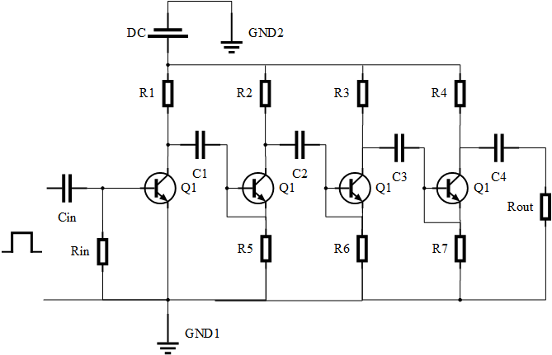
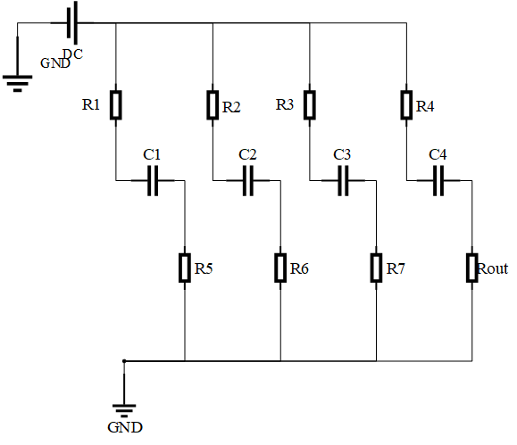
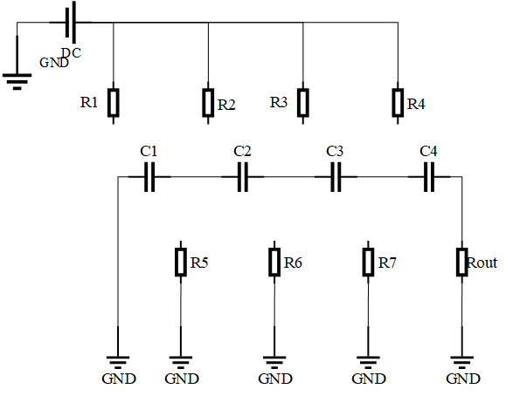
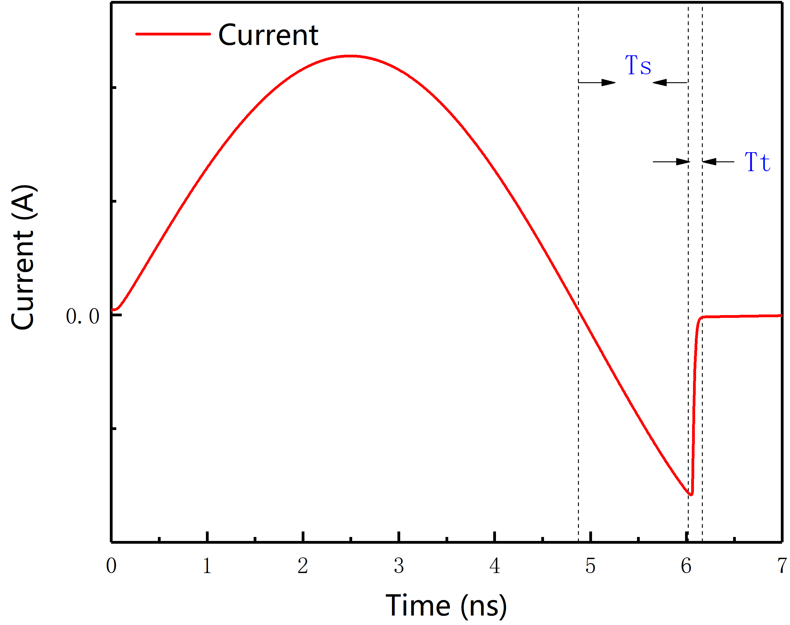
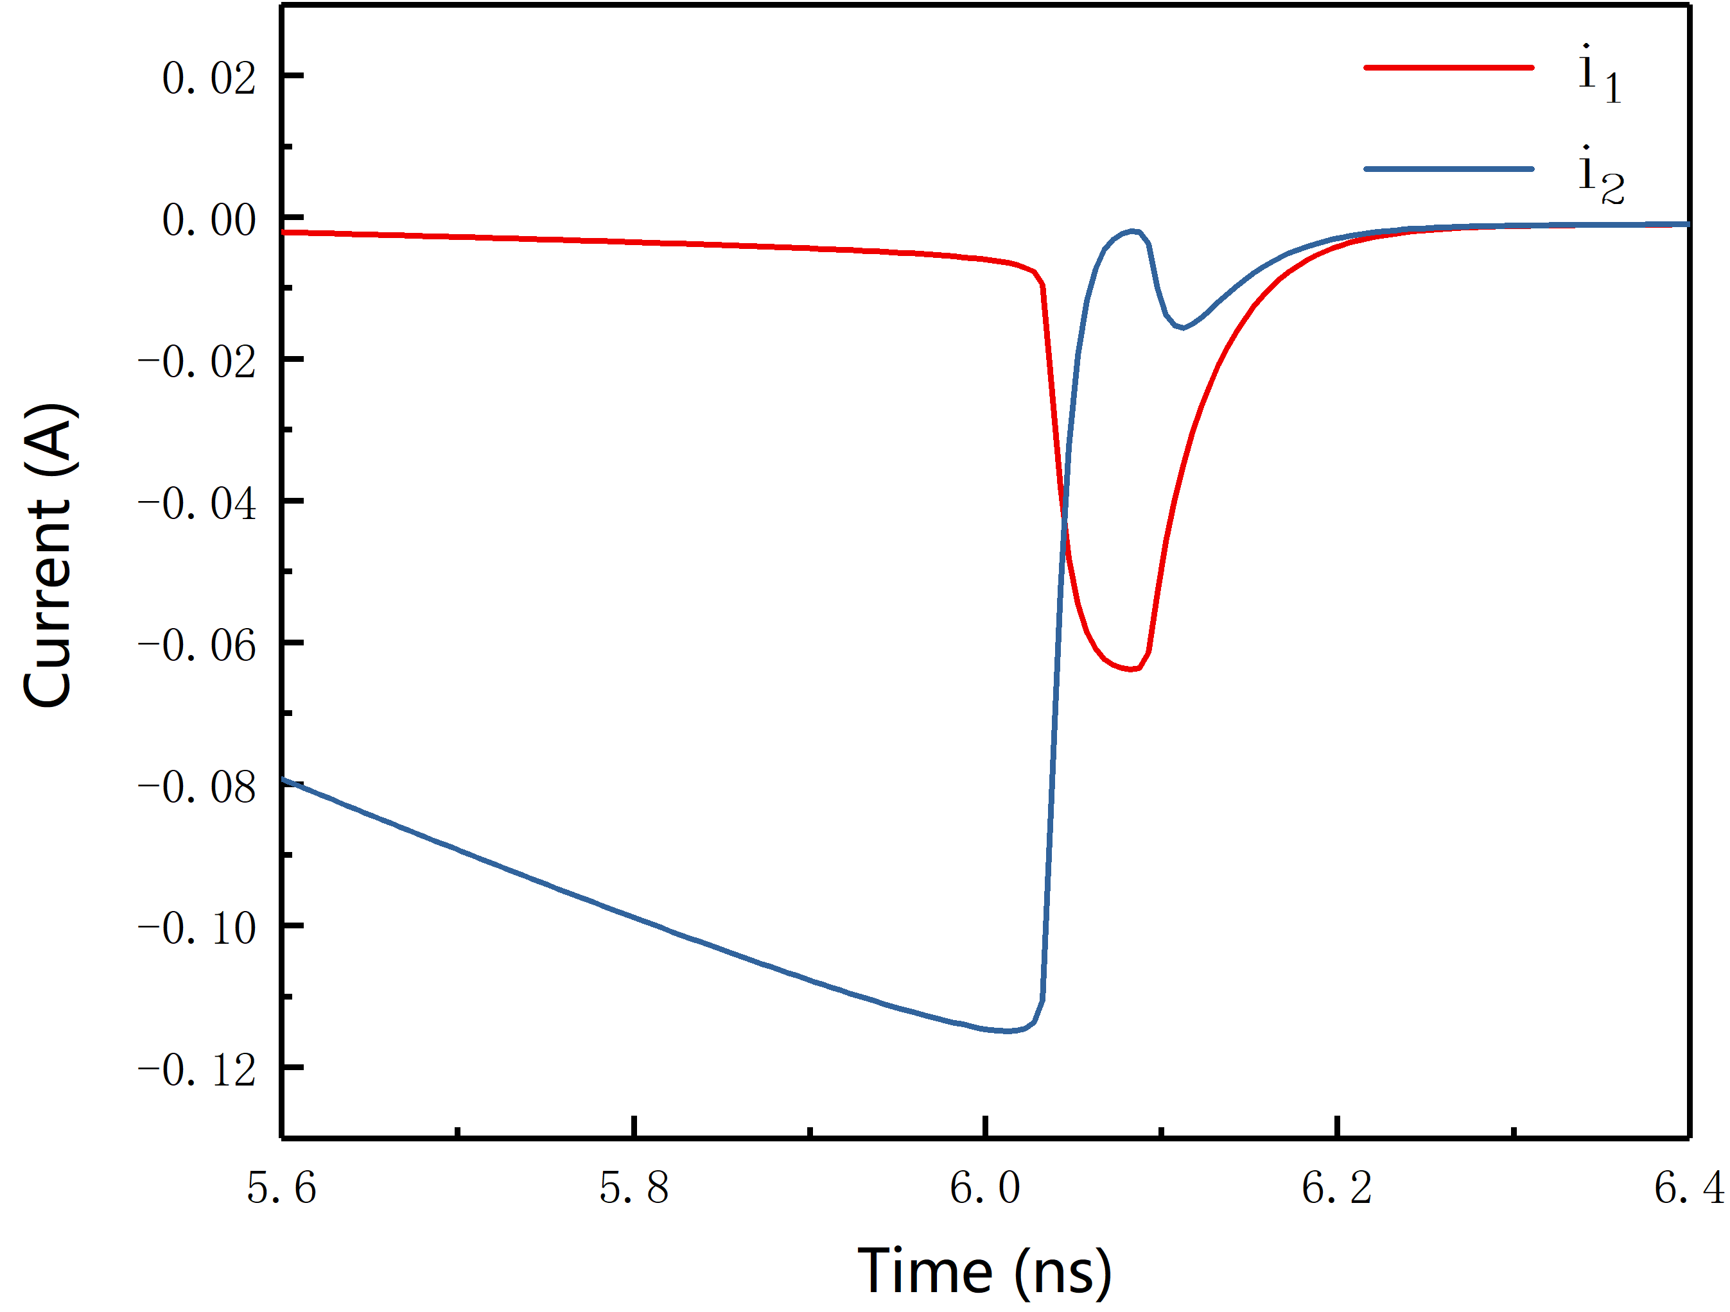
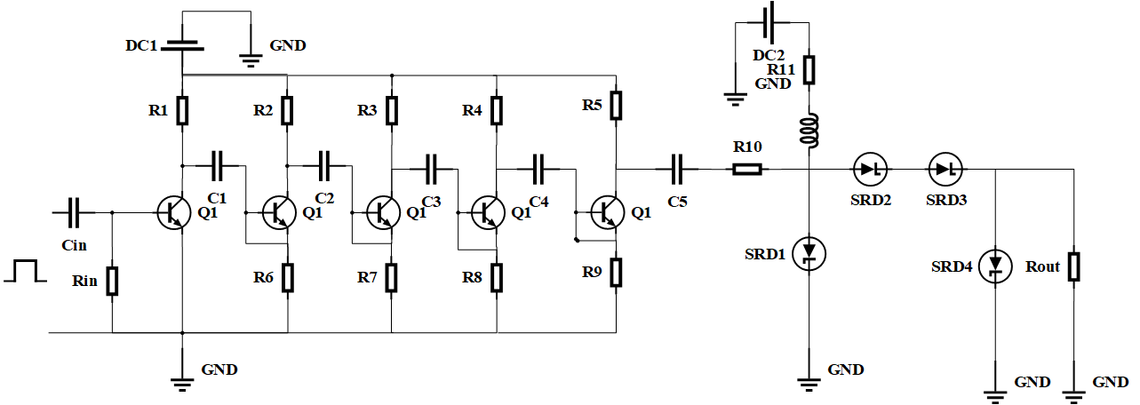
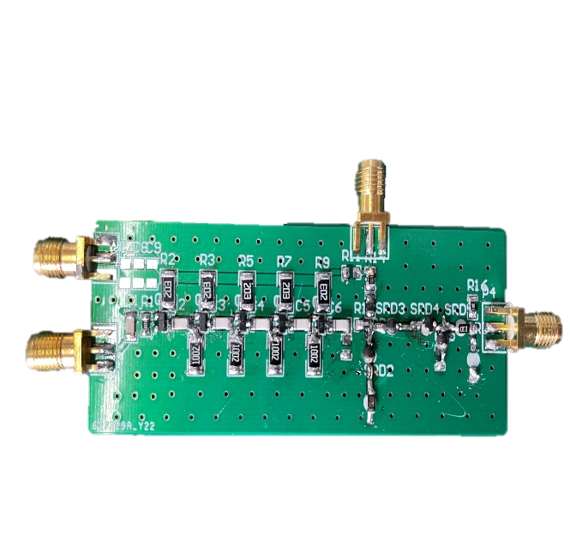
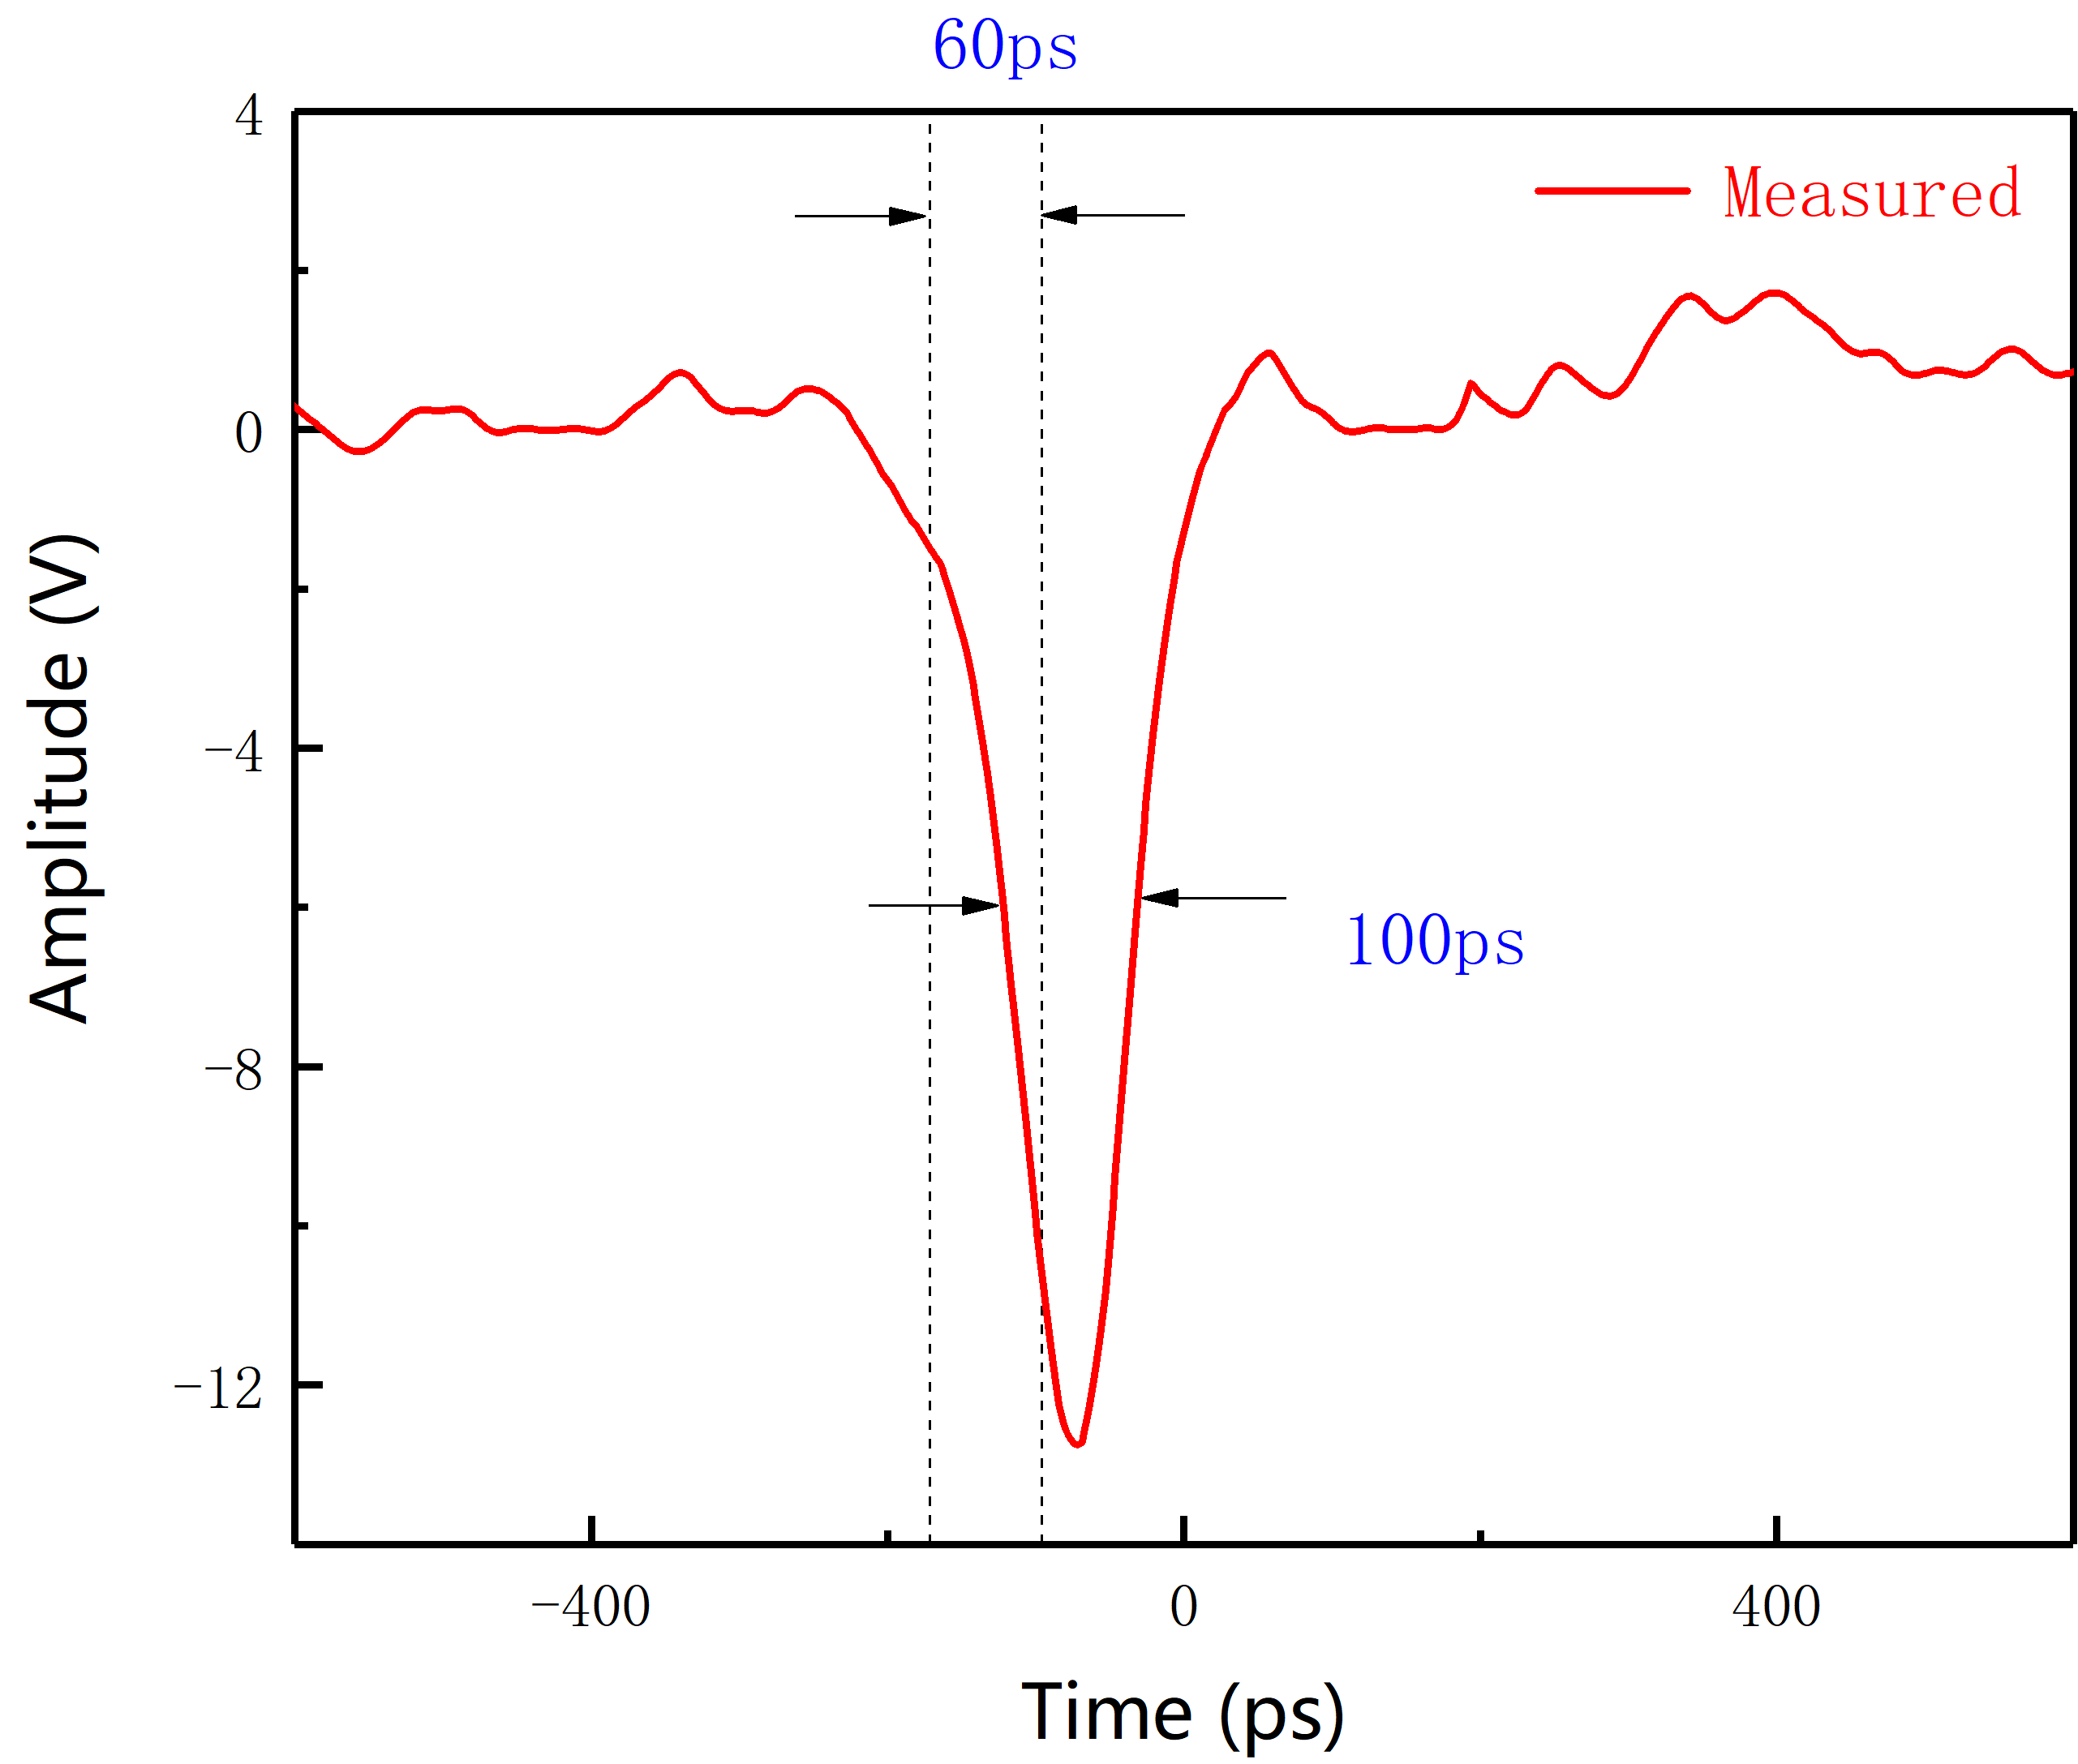
2021 IEEE 4th International Conference on Electronic Information and Communication Technology, Aug.18-20, 2021
A Novel Picosecond-Pulse Circuit Based on Marx Structure and SRD
Wenjing Xu, Juan Chen, Zhensheng Shi, Anxue Zhang
Introduction
Ultra-short pulse, owning with many superiorities of abundant spectrum, accurate handling and high resolution, has extensive applications such as ultra-wideband radar, biomedicine and time-domain reflectometry technique (TDR).
Analysis of principle
A lot of technological means have been adopted to obtain narrow pulse, such as all-solid-state Marx circuit, step recovery diode and integrated CMOS pulse generator.
Fig.1. Topology of Marx circuit
(a)
(b)
Fig. 2. Equivalent circuit: (a) the stage of charging, (b) the stage of discharging.
Fig. 3. The process of reverse recovery in SRD
Fig. 4. The process of current change in SRD1, SRD2, SRD3
Fig. 5. Topology of the proposed circuit
Experimental demonstration
Conclusion
The proposed circuit combines strengths of Marx circuit and SRD, which not only augments the amplitude of output voltage but also ensures ultra-short width. The designed circuit deploys the signal got from Marx circuit as stimulus to input SRD, with the purpose of sharpening edges of pulse. And one SRD in parallel with output load is aimed to diminish reverse voltage of pulse.
(a)
(b)
Fig. 6. (a) Physical diagram of the proposed circuit, (b) Measured waveform of output

