Slide 1
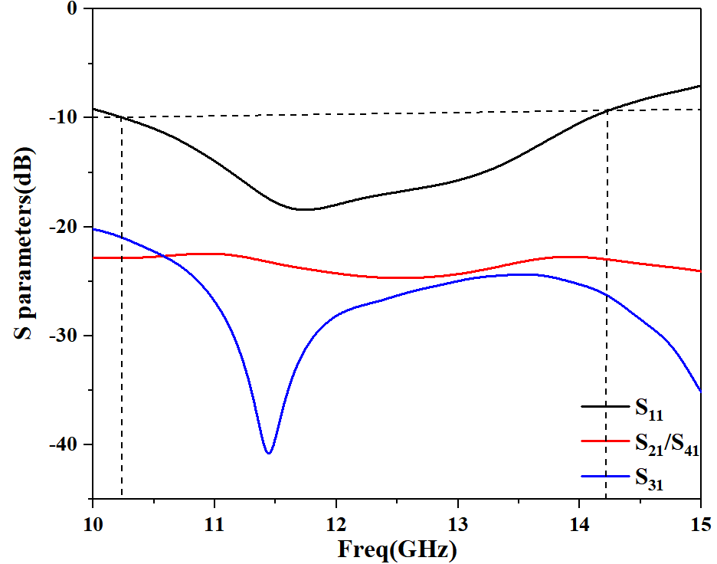
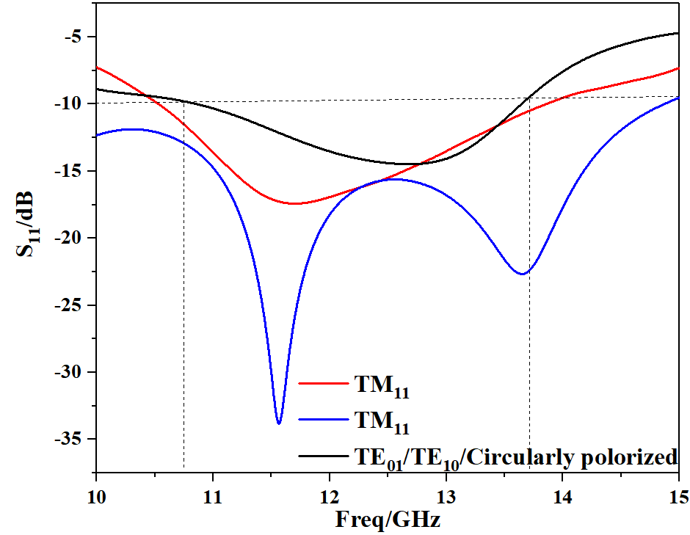
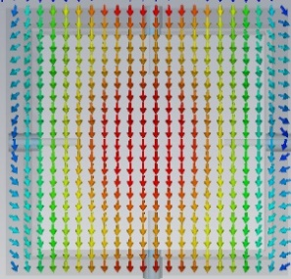
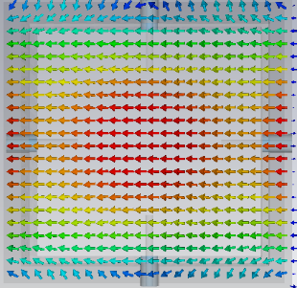
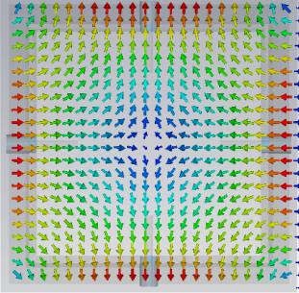
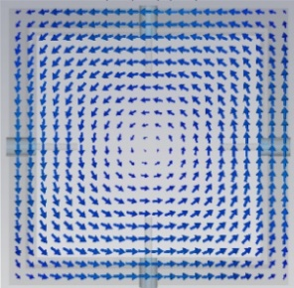
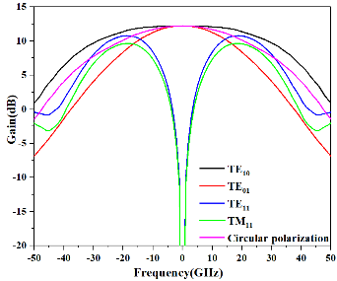
A Broadband Pyramidal Horn Antenna Applied to
Multi-mode Multiplexing
Wei Han, Hong-Wei Deng , Yong-Jiu Zhao, Yang-Kun Han
(a) (b)
(c) (d)
Fig. 4. Field lines of the four modes excited by coaxial-line adaptor:
(a) TE₁₀, (b) TE₀₁, (c) TE₁₁, (d) TM₁₁.
The ICEICT 2021 in Xi’an, CHINA
Abstract
Results
A new design of a broadband pyramidal horn antenna is realized, which can be applied to multi-mode multiplexing. To achieve the purpose of multimode radiation, a four-port coaxial-line adaptor has been designed to allow for the transmission of signals of required modes (TE10, TE01, TE11 and TM11). In addition, two circularly polarized waves with different rotation directions can be obtained by combining TE10 and TE01 on this basis. By controlling the amplitudes and phases of the signals from four feeding ports, the distribution of the fields in the waveguide will also be changed accordingly. The simulated results show that the simulated 10 dB return loss bandwidth is approximately 31.6% (ranging from 10.25 to 14.09 GHz, center frequency is 12.17GHz), and the isolation is less than
-20 dB. The return loss coefficients of the six different modes also meet the requirements (less than -10 dB) between 10.86 and 13.64 GHz.
(a) (b)
Fig. 2. (a) S parameters of different ports. (b) The reflection coefficient versus frequency of six modes.
Introduction
Fig. 2 shows that the simulated 10 dB return loss bandwidth is approximately 31.6% (ranging from 10.25 to 14.09 GHz, center frequency is 12.17GHz), and the isolation is less than -20 dB. It also indicates that in different frequency band for each mode, we can get different patterns. Between 10.86 and 13.64 GHz, all these modes can be excited respectively.
With the rapid development of communication technology and insufficient spectrum resources, how to improve real-time large-capacity signal transmission has become a hotspot today. To realize the simultaneous transmission of multiple types of signals, multi-mode multiplexing technology has been widely studied. In this paper, a broadband pyramidal horn antenna, which can be applied to multi-mode multiplexing, is realized. As shown in Fig. 1 (a), the horn antenna is composed of a square waveguide with a four-port coaxial-line adaptor and a horn section. From Fig. 1 (b), due to the symmetry of the structure of a square waveguide, a minimum number of probes can be used to excite the four fundamental modes and then they will be converted into radiation modes through the horn face. On this basis, two circular polarization modes can be obtained by combining TE10 and TE01 modes.
(a) (b) (c) (d)
Fig. 3. Field lines of the four modes excited by coaxial-line adaptor:
(a) TE10, (b) TE01, (c) TE11, (d) TM11.
Structure and methodology
The field monitors displayed in Fig. 3 show the TE or TM eigenmodes caused by corresponding excitation. Fig. 3(a-c) show the direction and intensity distribution of electric field for TE10, TE01 and TE11 respectively while the Fig. 3(d) shows magnetic field distribution of TM11.
(a) (b)
Fig. 1. (a) Porotype of the pyramidal horn antenna, (b) Sectional view of the feeding structure.
Fig. 4. Farfield realized gain of six modes at 12.17 GHz.
For the excitation of TE10, the coaxial ports can be excited by the excitation vector (+1, 0, -1, 0), which means +1 on port 1, 0 on port 2, -1 on port 3 and 0 on port 4. “+” and “-” respectively indicate that the signals flow into and out of the coaxial line. The direction of these currents is parallel to and along the same direction as the electric-field lines of TE10 so that only this mode can be excited at the operating frequency. The other modes cannot be excited because the electric-field lines of TE01 are perpendicular to the probes 1 and 3, and the signals from ports 1 and 3 of TE11 and TM11 will cancel each other. Similarly, excitation vector (0, +1, 0, -1), (+1, -1, +1, -1) and (+1, +1, +1, +1) can individually excite TE01, TE11 and TM11.
As Fig. 4 shows, TE10 and TE01 have a good performance in terms of antenna gain in the main radiation direction, while TE11 and TM11 have deep nulls. The gain of each circularly polarized wave is between that of TE10 and TE01, which is reasonable because it is a combination of these two modes. These results are consistent with the field distribution diagram in square waveguide. Since the guided waves are independent of each other, they are orthogonal and have no coupling during transmission. If more than one antenna is used to transmit signals, multiple antennas can radiate waves of different modes at the same time in the same frequency band, thus forming a multi-mode multiplexing antenna. In this way, real-time large-capacity signal transmission is realized and this is of great benefit to improving frequency band utilization.
Additional phase information needs to be added to form circularly polarized waves. We can set excitation vector (+1, +1, -1, -1) with phase shift (0°, 90°, 0°, 90°) to combine TE10 and TE01 into a left-handed circularly polarized wave. It is absolutely that the amplitude component of the right-handed circularly polarized wave composed of these two modes is the same as the above, but it has phase shift (90°, 0°, 90°, 0°).
CONCLUSION
In this paper, a broadband pyramidal horn antenna that can be applied to multi-mode multiplexing is designed. Loading four coaxial-line probes distributed around a square waveguide, the horn antenna can realize four radiation patterns of different modes (TE10, TE01, TE11 and TM11) only by controlling the amplitudes and phases of the signals from four feed ports. Besides, circularly polarized waves are obtained by combine TE10 and TE01 with additional phase information. The simulated results obtained from EM full-wave simulation show this antenna has great performance in its frequency band and six different radiation patterns are acquired. This design is expected to be applied to multi-mode multiplexing to improve the utilization of frequency band.
Team Member
Professor Yong-Jiu Zhao, Hong-Wei Deng , Wei Han, Yang-Kun Han, Xin-Yu Yang, Nan Sun
Contact Person: Wei Han
E-mail: hanyuhu@nuaa.edu.cm
College of Electronic and Information Engineering
Nanjing University of Aeronautics and Astronautics
29 Jiangjun St., Nanjing, China, Post Code: 211106

