Slide 1
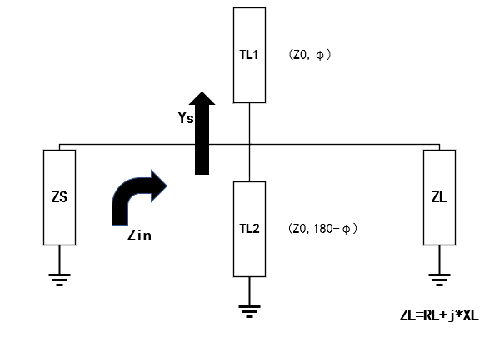


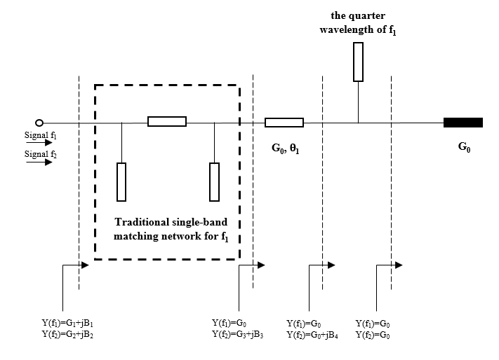

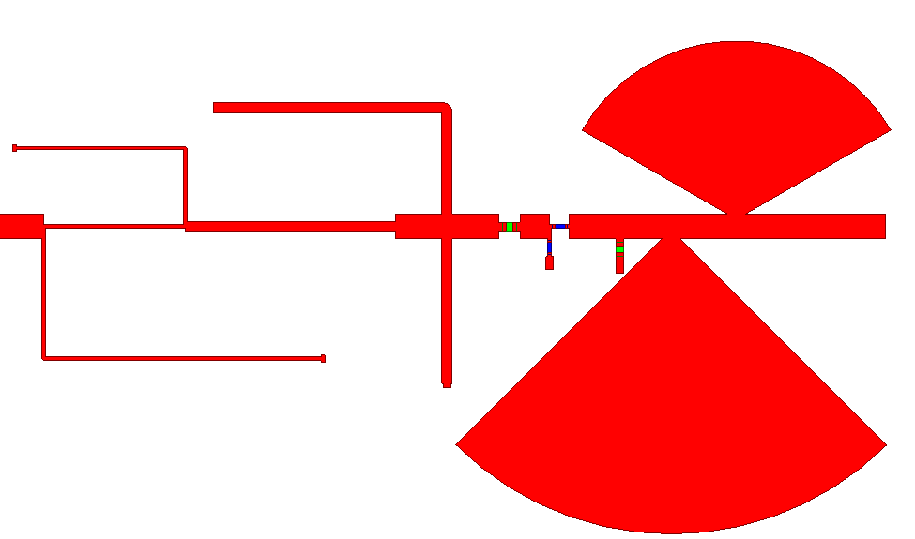
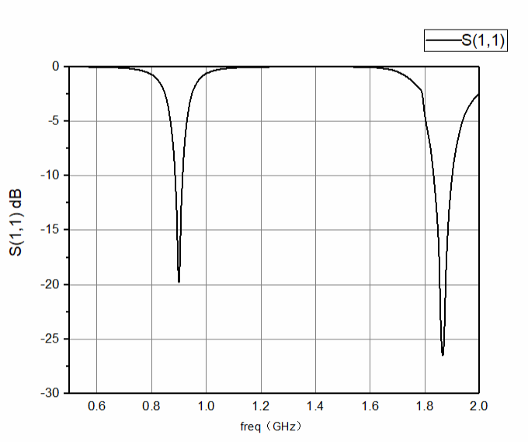
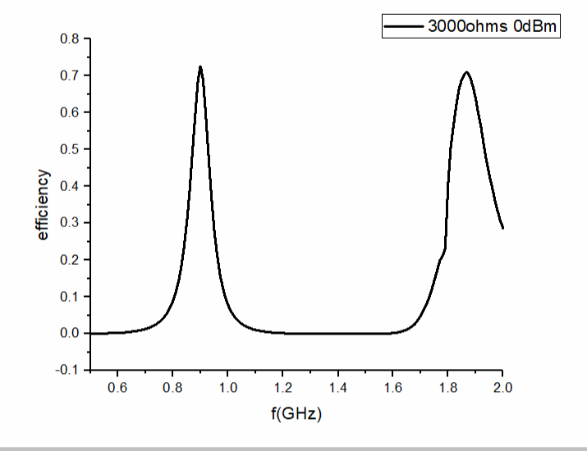
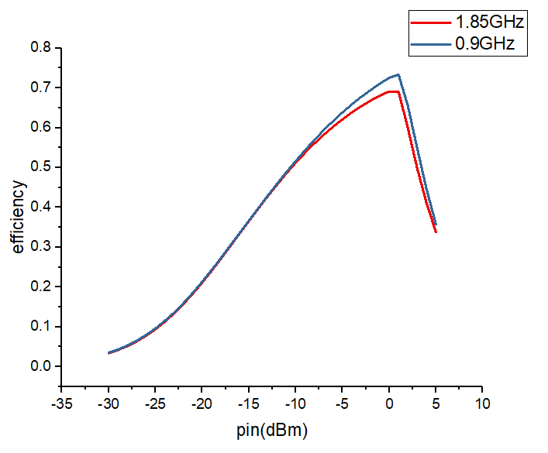
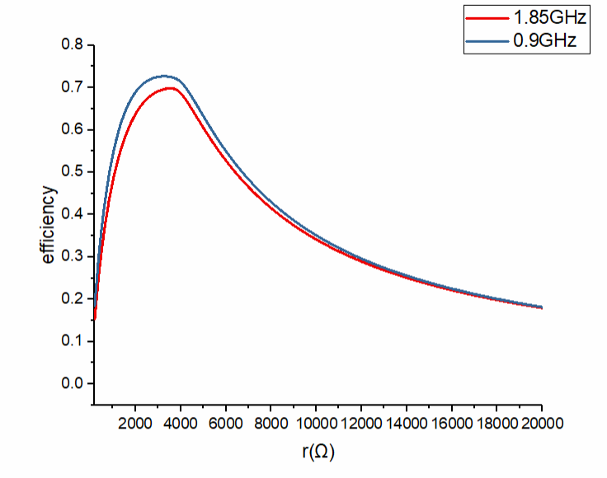
A New Wide Dynamic Range Rectifier Circuit for Ambient RF Energy Harvesting
Ziyue Li, Qian Yang, Jianxing Li*
School of Information and Communications Engineering, Xi’an Jiaotong University, Xi’an, Shaanxi 710049 China
*jianxingli.china@xjtu.edu.cn
Abstract- A new dual-band rectifier circuit for ambient radio frequency (RF) energy harvesting is proposed. Due to the existence of Schottky diode as a non-linear device in the rectifier circuit, the input impedance and echo characteristics will change dramatically with the load size and input power, so it has been challenging to design a multi-band high efficiency rectifier with high dynamic range. Therefore, an improved impedance compression technique is proposed to adjust the impedance range of nonlinear diode with high dynamic range to a smaller rangeover 95%, and the left-handed circular polarization (LHCP) gain is 7dB with a cross-polarization level of less than -28dB. The impedance bandwidth is 1% within which the axial ratio is less than 2dB. The proposed antenna has the advantages of high efficiency, excellent circular polarization purity, and low cross polarization level.
(a) (b)
Figure 2. Topology of impedance compression network.
INTRODUCTION
In recent years, with the coverage of 5G technology, a variety of emerging technologies such as the Internet of Things, smart cities and so on are flourishing. At the same time, the high cost of battery maintenance and replacement has emerged. Therefore, obtaining wireless energy from the external environment has become a hot spot gradually.
As the most important part of rectenna, rectifier circuit realizes the conversion of RF energy to DC energy through the unidirectional conductivity of rectifier diode. In order to improve the rectifier efficiency, the rectifier circuit needs to meet the requirements of low loss, high sensitivity and dynamic power processing capacity.
Most of the rectifiers studied in most studies do not have high efficiency in simulation in practice, and few studies involve the study of high dynamic range of rectifiers, which results in the design of rectifiers that can’t be made and used in practice. Therefore, this paper is based on this situation. A high efficiency rectifier with high dynamic range (input power range from -15 to 10, load resistance from 500 to 30000) is designed. Its operating frequency is GSM900 (850-910 MHz), GSM1800/4G (1850-1900 MHz). The rectification efficiency is about 70% when the input power is 0 dBm, and it can maintain 30% conversion efficiency in a large dynamic range.
As shown in the Fig.2 is the schematic diagram of the new impedance compression network, a parallel transmission line with the same characteristic impedance at both ends is added between the rectifier circuit and the impedance matching network: a section of parallel open circuit is directly connected with a section of parallel open circuit branch and a section of parallel short circuit branch, the sum of the electrical length of the two parallel branches is equal to 180 degrees, and the electrical length of any parallel branch is not equal to 90 degrees 0 or 180 degrees. By adding these two parallel branches with the same characteristic impedance, the impedance change can be controlled in a narrow range.
The overall impedance of the back-end structure of the impedance compression circuit is as follows:
TL2 is a short-circuit branch with an electrical length of ф , TL1 is an open branch with an electrical length of 180-ф,Therefore, the overall admittance of the branches at both ends is as follows:
Finally, the impedance of the circuit after the impedance compression network is obtained as follows:
Figure 1. Topology of impedance matching network.
Figure 3. The proposed topology of dual-band rectifier
ANTENNA DESIGN
Impedance matching is very important. The quality of impedance matching will directly affect the signal strength received by the back-end rectifier circuit, thus affecting the rectifier efficiency of the whole circuit. The new impedance matching network used in this paper is shown in the Fig.1 The two frequency points of dual band are denoted as f1 and f2 respectively. For f1, the admittance is G1+jB1. For f2, the admittance is G2+jB2. As shown in the Fig.1, first through a π-Type matching network matches f1 to standard impedance. At this time, the admittance of f2 is G3+j*B3, after that, the characteristic impedance of a section in series is 50 0Ω. The transmission line changes the admittance of f2 to G0+j*B4, and G0 is the standard admittance with the size of 0.02. Finally, a section of transmission line with the quarter wavelength of f1 is paralleled to change the admittance of f2 into standard admittance.
In this process, because the frequency points of f1 have been matched, series connection of 50 Ω characteristic impedance line has no effect. At the same time, the quarter wavelength parallel transmission line is equivalent to open circuit, which has no effect on the matching effect. Therefore, the matching structure can match another frequency point without affecting the matched frequency point. The bandwidth is wide and the matching effect is good.
Figure 4. The performance of dual-band rectifier

