Slide 1

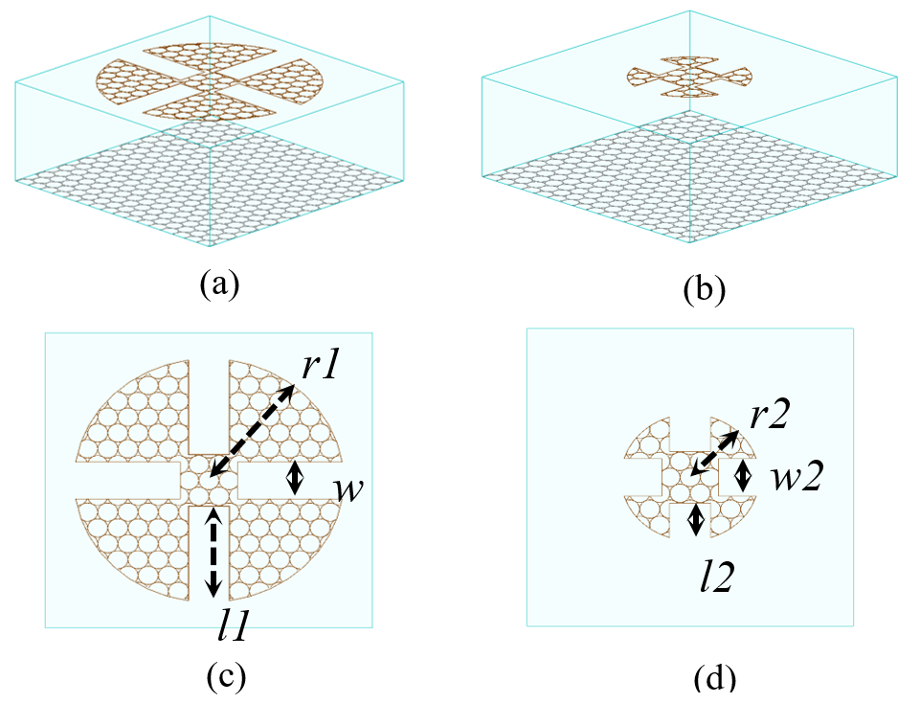
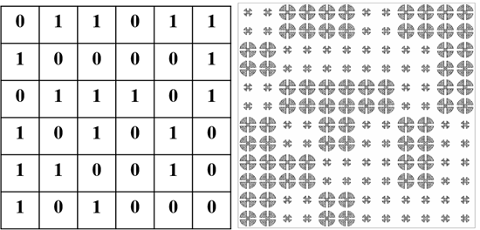
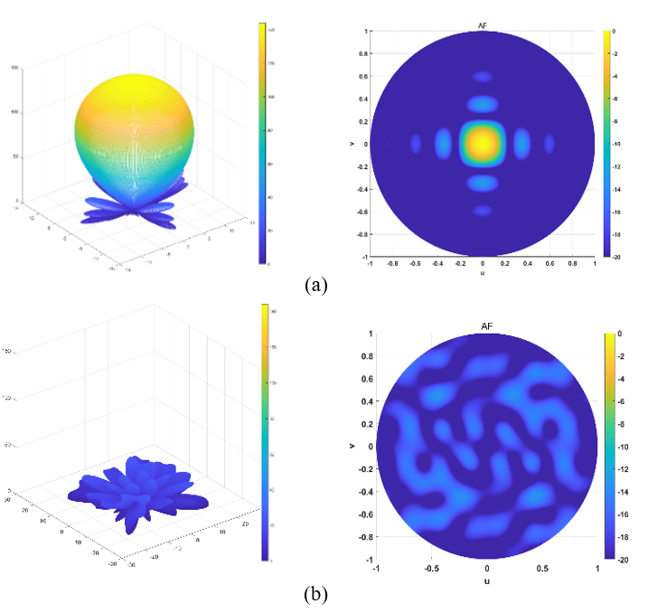
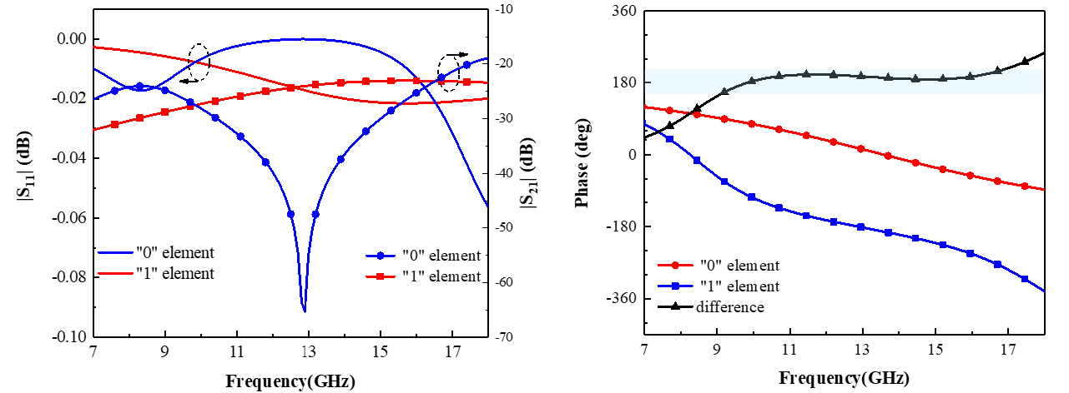
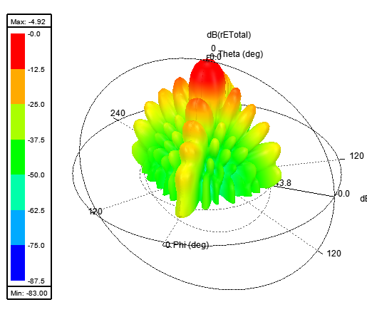
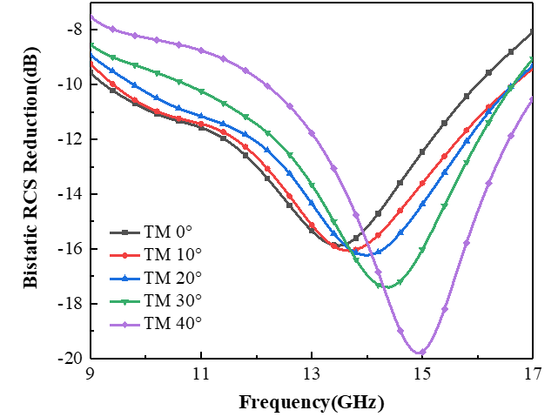
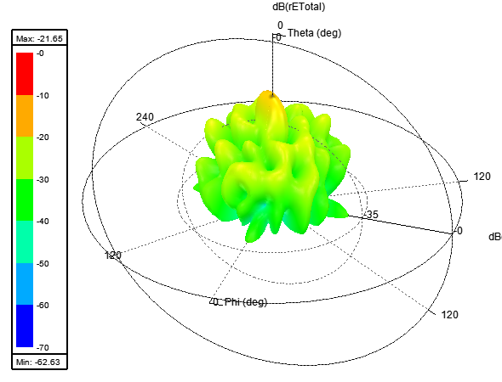
Optically Transparent Diffusion Metasurface Using Metallic Mesh
Ya-Qi Wei*, Jian-Zhong Chen, Lei Lin, Yu-Tong Zhao, Jia Chen
E-mail: yqweii@qq.com.com
Abstract
A novel optically transparent diffusion metasurface composed of 1-bit coding elements is presented. Two circular quasi-Minkowski closed-loops with different geometric scales are considered as 1-bit coding elements. The quasi-Minkowski closed-loops on the upper layer of the substrate and the back-ground on the lower layer are filled with metallic tangent ring mesh to improve the light transmittance. Low scattering is achieved by redirecting EM energies to all directions through optimization of the arrangement of coding elements. The low back-scattering characteristics with wide-angle and polarization independence below –10 dB of the diffusion metasurface are achieved over a wide frequency band from 9 GHz to 16 GHz. The proposals offer new opportunities for manipulating the microwave scattering with simultaneously high optical transparency in visible frequencies and demonstrate significant scientific value in practical applications.
Diffusion Metasurface Design
A.Unit Cell Design
B. Arrangement
Fig. 3. Optimal layout of the diffusion metasurface.
Fig. 1. The unit cell of the proposed transparent 1-bit coding metasurface.
(a) The three-dimensional (3D) view of the “0” element and (b) of the “1” element. (c) Top view of the “0” element and (d) of the “1” element.
Fig. 2. Simulated reflection spectra of the coding elements.
Fig. 4. The calculated scattering fields of (a) the uniform coding sequence and (b) the optimal coding sequence.
Results
Figure 6. Simulation results of 3D scattering field pattern. (a) metal (b) diffusion metasurface.
Figure 7. Simulation results of bistatic RCS reduction.
Fig. 5. Simulation results of monostatic RCS under the normal incidence.
Conclusions
A novel optically transparent, broadband, wide-angle, low-scattering and polarization-insensitive 1-bit coding metasurface based on a symmetric circular quasi-Minkowski closed-loop is presented. Simulations results demonstrate that the reflection energy of the metasurface is scattered in various directions from 9 GHz to 16 GHz and incident angles of up to 40°, so in each direction of the energy for scattering is small based on the energy conservation principle.

