Slide 1
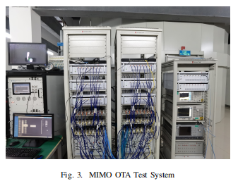
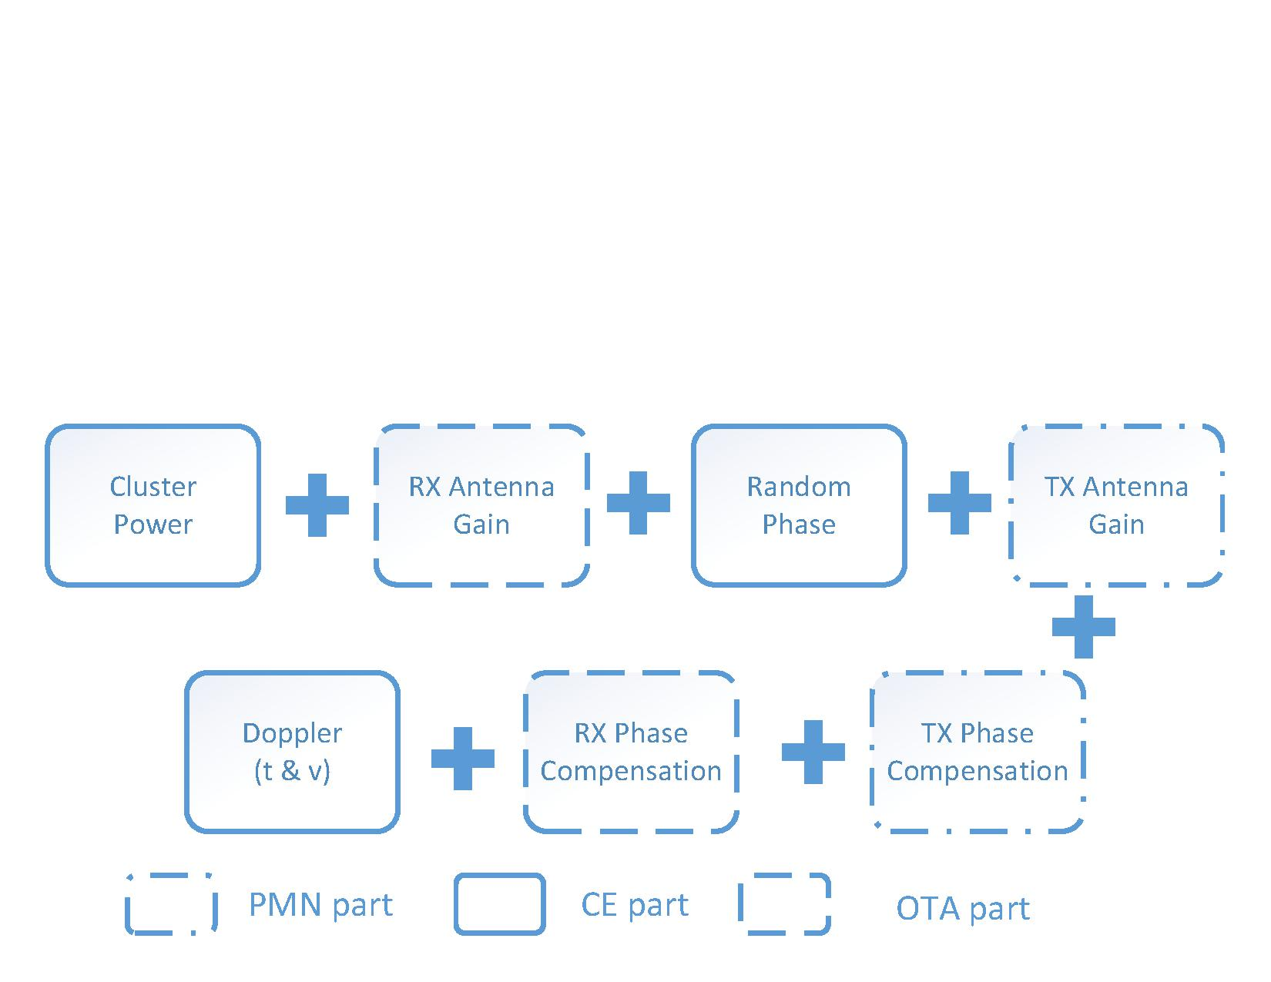
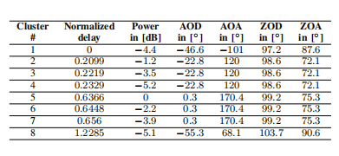
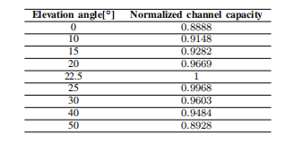
Channel Emulation based on 3D End-to-End MPAC
Solution
Yichen Zhao¹, Yuhang Guo^{*2}, Yanyan Cao¹, Jiasong Mu¹,
Hengjiang Wang¹, Xiang Zhang²
Abstract—As 5G commercialization speeding up, 5G wireless devices are in the stage of accelerated research, development and manufacturing., A major feature of 5G base station is the application of massive multiple input and multiple output (MIMO) technology so the performance testing of 5G MIMO is a significant part ensuring the performance of 5G mobile networks. This paper introduces an end-to-end over-the-air (OTA) performance test system for 5G terminals in 3D scenarios, where uplink and downlink communication is realized via different OTA probes while guaranteeing the system reciprocity. Meanwhile by adopting phase modulation network, the system significantly saves the number of channel emulator radio frequency (RF) ports while guaranteeing the features of the entire gNodeB.Besides, a discretization probe weight calculation scheme for 3D OTA anechoic chamber is proposed to construct the 3D channel propagation environment. Simulation and test results show that the system can accurately be qualified for MIMO OTA end-to-end performance testing.
Index Terms—5G, OTA, Performance testing, Spatial correla-tion
¹ China Mobile Group Device Co., Ltd, Beijing, China
² China Academy of Information and Communications Technology, Beijing, China
email:guoyuhang@caict.ac.cn
IV. SYSTEM VALIDATION AND TEST RESULTS
The 3D end-to-end MPAC performance system is constructed by HUAWEI’s gNB with 64 RF channels, Topyoung’s phase shifter, Spirent Vertex’s channel emulator and Shenzhen General Test’s 3D MPAC chamber, shown in Fig.3. Channel characteristics are validated in the system. Meanwhile, MIMO OTA performance test results are carried out for the flagship 5G phones in the markets.
A. Channel Model Validation
Power Delay Profile (PDP), Doppler correlation, spatial correlation and Cross-Polarization Ratio (XPR) are the key indicators of channel model validation as in [5]. Among these factors, PDP focuses on verifying the correctness of
where$\vec{d_{u}}$ $\vec{d_{v}}$ represent the position vector of $u,v$ respectively.$\vec{Ω}$ is the unit vector of signal direction, which satisfies $\vec{Ω}=\left[\sin\left(θ\right)\cos\left(φ\right),\sin\left(θ\right)\sin\left(φ\right),\cos\left(θ\right)\right]$It should be noted that,3D power angle spectrum P(Ω) is not explicitly defined in 3GPP specification. In case that, 3GPP defines N rays in each cluster, and the power of each ray is$P_{n}$, with$\sum_{n=1}^{N}{P_{n}=1}$details of ray angle distribution is presented in [6].
According to above the discrete PAS formed by the OTA anechoic chamber probe is used to fit the continuous objective function, which is expressed by the following formula
I. INTRODUCTION
As the new generation of mobile communication system,5G aims to solve the problems of high latency, small system capacity, and low transmission rate in existing mobile communication networks. In order to fulfill these dramatic improvements, massive multiple input and multiple output (MIMO) and beamforming techniques are introduced. Currently, 5G has been adequately commercialized. As an essential part in the 5G industrial chain, the performance testing of 5G MIMO base station (BS) i.e., gNodeB (gNB) and user equipment(UE) has become a significant item.
For the performance testing of 5G MIMO terminal, the general solution is adopting over the air (OTA) technology [1]. The basic idea of OTA is using anechoic chamber to establish a no-reflection free space, reproducing target environment in the lab so as to evaluate the overall performance of the UE. Now the OTA test system based on multi-probe anechoicchamber (MPAC) is the most universal method, which has been standardized by the wireless association[2], while that for the 5G new radio (NR) UE is under discussion in the third generation partnership project(3GPP). In MPAC, the cross_x0002_polarized probes are evenly distributed around the anechoic chamber, allocated with different power weights by channel emulator. Then a test environment with certain delay, Doppler and power distribution which meets the requirements of specific channel model is reproduced [3]. As a consequence, the performance of the UE in a specific channel environment can be precisely measured.
$$ρ_{v,v}=\sum_{n=1}^{N}{P_{n}}exp\left\{−j\frac{2π}{λ}\left(\vec{d_{u}}−\vec{d_{u}}\right)\vec{r_{n}}\right\}$$
(3)
$\vec{r_{k}}=\left[\sin\left(θ_{n}\right)\cos\left(φ_{n}\right),\sin\left(θ_{n}\right)\sin\left(φ_{n}\right),\cos\left(θ_{n}\right)\right],$ $θ_{n}$ and $φ_{n}$are the direction of n − th ray.
In the OTA environment, assuming that there are totally K probes, the weight of k − th probe is expressed as $ω_{κ}$,
Fig. 2. The Schematic diagram of MIMO OTA system
$${\hat{ρ}}_{u,v}=\sum_{n=1}^{N}{ω_{k}}exp\left\{−j\frac{2π}{λ}\left(\vec{d_{u}}−\vec{d_{u}}\right)\vec{r_{k}}\right\}$$
(4)
where $\vec{r_{k}}=\left[\sin\left(θ_{k}\right)\cos\left(φ_{k}\right),\sin\left(θ_{k}\right)\sin\left(φ_{k}\right),\cos\left(θ_{k}\right)\right]$. In this system, the downlink and uplink signal transmits via different OTA probes in order to ensure signal strength. Since the target SC for both links are consistent, the SC optimization results of downlink and uplink needs to be very similar to ensure the reciprocity of the channel. Hence, for calculation of uplink${ ω}_{k′}$,$\vec{r_{k}}$ is replaced by $\vec{r_{k′}}=\left[\sin\left(θ_{k}−θ′\right)\cos\left(φ_{k}−φ′\right),\sin\left(θ_{k}−θ′\right)\sin\left(φ_{k}−φ′\right),\cos\left(θ_{k}−θ′\right)\right]$, $θ′$and $φ′$are the angle difference between uplink and downlink.
Fig. 3. MIMO OTA Test System
The 5G Massive MIMO system can support dozens of inde-pendent spatial data streams at the same time by increasing the number of BS antennas, which obviously improves the spectral efficiency. According to the products guideline of network vendors in FR1, there are 64 transmission and reception radio frequency (RF) ports equipped on the gNB. Each RF port is mapped into 2 or 3 antenna elements to further enhance the antenna gain. In order to establish a 5G MIMO OTA test system, considering there are 64 ports on gNB and at least 8 cross-polarized probes deployed in OTA chamber, at least 64 × 16 bidirectional MIMO links are needed. The total RF ports cannot be afforded by one channel emulator, and the cost will increase significantly.
power and delay of channel model impulse response. Doppler frequency offset caused by the velocity is validated by Doppler correlation. XPR is the leakage ratio between horizontal polarization and vertical polarization. The fitting goodness of
spatial correlation is the most important metric of channel model validation, whose detail is in next paragraph. 3GPP standardization approaches in [5] are adopted to validate PDP, Doppler correlation and XPR in our system. Channel model is configured based on CDL-C, with velocity of 3km/h and 30km/h, and normal delay spread at China Mobile’s band(n41). PDP Doppler and XPR coincide with the theoretical results approximately.
In [3], a 3D sector-shaped MPAC setting was proposed for Massive MIMO gNB, which replaced the actual probes set by the MPAC with a phase matrix, and reduced the number of channels at the gNB. [4] discussed solutions for massive MIMO BS performance testing. 3GPP stipulated in [5] that the 5G FR1 frequency band adopted a two-dimensional MIMO OTA test system layout to test the performance of UE. While for 5G test system, the overall performance from the massive MIMO gNB to the UE needs to be considered, both downlink and uplink performance should be measured.Besides the signal transmission in free space is not only limited to the horizontal dimension, but also extended to the vertical dimension.
In response to above-mentioned requirements, this paper constructs an end-to-end performance test system for 5G MIMO OTA. This system consists of a 64-port 5G gNB, a phase modulation network, a channel emulator (CE), power amplifiers as well as a 3D MPAC. The uplink and downlink communicate via different probes, and through different power amplifier units to ensure signal strength, supporting the multi-mode two-way reciprocal OTA channel environment. By adopting the phase modulation network, the cost of CE ports can be greatly reduced. In addition, this system adopting a discretization probe weight calculation scheme to bulid the 3D channel environment, making the evaluation result more reliable.
III. TEST MODEL
A. Channel model
Channel modelling for this system is based on the CDL channel defined in [6]. However, the number of clusters in these models are large and the angles are widely distributed. In order to reduce the computational complexity, it is necessary to simplify the channel model according to the hardware capability and the real scene. According to the clusters filter principles provided in [8], the CDL-C model can be simplified to eight clusters in four directions.
This system innovatively puts forward the realization scheme of bidirectional channel, using 3D MPAC chamber. In addition to verifying the 3D downlink spatial correlation, it is still necessary to verify the 3D uplink spatial correlation, and the theoretical profiles of downlink and uplink are the same. Regarding the sample points selection of the test area, in LTE system, CTIA chooses points from -0.5 to +0.5 wavelengths from the center of the test volume, 90 degrees axis in XOY plane of the global coordinates [9]. To accurately evaluate the spatial correlation of the whole 3D space in OTA chamber, a 3D sample scheme is proposed in this system. In addition to the suggested axis in CTIA, a vertical axis that passes through the center of test zone (TZ) is also selected. The sample range for each axis is between -10cm and +10cm with 1cm sampling interval.
B. Test system
The test system solution constructed in this paper is shown in Fig.2. On the gNB side, the phase modulation network is connected, simulating the gNB beam selection process. On the UE side, the anechoic chamber adoptes a 3D structure. Eight, sixteen, and eight pairs of dual polarization probes are evenly distributed in the upper ring, middle ring, and lower ring, respectively. The probes are divided into two groups according to their location distribution. The downlink and uplink communicate through different links. One group (blue probes in Fig. 2) is responsible for the downlink, where the gNB signal reaches the center of the anechoic chamber after being amplified by the power amplifier. The other group(yellow probes in Fig. 2) is responsible for the uplink, where the UE signal returns to the channel emulator through the lownoise amplifier. This method ensures the reciprocity of both links, while enabling a strong received signal power level of the UE in the MPAC.
For the structure of the system, the horizontal probe ring follows 3GPP solution. Regarding the elevation angle of the 3D OTA probe ring, this system uses upper and lower probe rings with an evaluation angle of ±22.5◦ to the middle ring. The simulation results in the Table.II below show that when the elevation angle of the upper and lower probe rings
By this means, Fig.4 demonstrate the spatial correlations of the TZ plane and the vertical axis. The measured spatial correlation curve profile within -0.05m to 0.05m basically fits the theoretical profile, successfully restore the CDL-C channel model based on 3D MPAC scheme.
B. Terminal’s Test Results
With the complexification of 5G technology evolution,multiple challenges are brought for hardware design, scheme integration, performance evaluation and optimization of 5G
Fig. 1. Channel matrix split diagram
The rest of the paper is organized as follows. Section II introduces the principle of the MIMO OTA system modelling and proposes a probe weights optimization scheme based on pre-faded signal synthesis (PFS) algorithm. In Section III, details of system architecture are described and the advantages of the MPAC probe layout are discussed. The channel verifi-cation results of the 3D end-to-end MPAC system are shown in Section IV, then the significance of solution is demonstrated by terminal test results. In the end, Section V concludes the paper.
TABLE I
CHANNEL MODEL PARAMETERS FOR CDL-C CHANNEL
Fig. 4. Horizontal spatial correlation validation results
Fig. 5. Vertical spatial correlation validation results
Fig. 6. Performance of 6 flagship phones averaged in case of CDL-C
terminal test system. MIMO in transceiver is the key technology to improving 5G rate performance. Terminals’ space for antennas is limited, so it is a great challenge to ensure spatial independence between multiple antennas. For 5G phones, there are higher requirements for antenna layout optimization, complex protocol implementation, and processing capacity, which require collaborative optimization of terminals and chips. Six flagship phones launched in 2020 are evaluated in our system. To avoid system’s background noise influence on terminals, the transmitting power of gNB keeps constant, and Gaussian white noise is adjusted to compare terminal
performance under different SNR. In addition, terminals’ performance in different positions are also compared, including 45 degrees horizontal (receiver to the left) and 45 degrees vertical (receiver to the up). The average performance of phones are shown in Fig.6. Following conclusions can be drawn from the results.
1) Multi antenna performance of terminals in highfrequency offset scenes is
poorer than low-frequency offset, because of chips’ demodulation performance.
2) In case of 30km/h, downlink throughput of vertical terminal is 5-10 percent
higher than horizontal terminal.Consequently, high-frequency offset scenes and
hori zontal multi-antenna terminal performance are the key research items in
mobile gaming scenario.
3) Performance balance in different positions still need to be optimized, according to
radiation pattern.
II. SYSTEM PRINCIPLE
The channel impulse responses for 5G scenario are introduced in TR 38.901. According to the channel generation formula for a specific link, each cluster can be divided into three sub-processes: the signal transmission sub-process, that is, the beamforming process at the gNB, including transmission antenna gain and the signal transmission phase; The signal propagation sub-process,that is, the scattering and crosspolarization of the signal in free space, including cluster power and phase changes; The signal receiving sub-process, that is,the beam receiving in the OTA, including receiving antenna gain, signal receiving phase difference, speed and time.
The test system is composed of a phase modulation network (PMN), a channel emulator and an OTA anechoic chamber,which are responsible for the three parts mentioned above,respectively. The phase modulation network in the gNB side simulates the signal transmission sub-process, the UE side adopts the 3D OTA anechoic chamber simulates the signalreception sub-process, and the channel emulator simulates the signal propagation sub-process. Therefore, the channel matrix can be split into several parts, as shown in Fig.1.
The phase modulation network connects all RF ports of the gNB, simulating the beamforming function of the base station by adjusting the amplitude and phase of different links [7]. After the selecting and combining of the clusters in the channel model, the number of output ports is reduced, which successfully saves instrument resources.
TABLE II
CHANNEL CAPACITY COMPARISON FOR DIFFERENT ELEVATION ANGLES
In MPAC OTA system, by assigning different power weights to each probe, a specific fading conforming to the target channel is formed in the center of the anechoic chamber. There are two algorithms, namely pre-faded signal synthesis (PFS) and plane wave synthesis (PWS), which are widely adopted to optimize the weight of the probe. Because the PFS algorithm is not affected by the phase fluctuation of the system and more robust, this system adopts the PFS algorithm for OTA channel modeling.
For the PFS method, in order to accurately reproduce the target channel model, spatial correlation (SC) is selected as the evaluation factor. It is necessary to ensure the test space SC $\hat{ρ}$ as consistent with the theory SC $ρ$ as possible. When the OTA probe locations are fixed, the SC optimization function appears as a convex optimization problem. With the limitations that the probe weights must be normalized and should be nonnegative number. The optimization problem can be expressed as the following formula [3]
is located near this angle, the channel capacity can reach maximum value. Besides, the uplink and downlink probe rings are interleaved in turn, which can better fit the uplink and downlink channels.
By the amplitude and phase adjustment function of the phase modulation network, the 64 ports of gNB can be simplified to 16 ports. Even considering the structure of the 3D probe ring applied in the anechoic chamber, the entire link is still restricted within 16×32 for single link.In practical, the elevation arrival angle of the signal rarely reaches beneath the UE. So the OTA probe ring can only choose the upper ring and the middle ring, reducing the links to 16 × 24. Compared with the original 64 × 32 channel requirement, the hardware cost is greatly saved.
V. CONCLUSIONS
In this paper, a channel emulation solution based on 3D end-to-end MPAC is proposed. The geometric growth in the number of gNB and UE antennas is the key factor to leaps in 5G network performance. To quantify the performance of 5G terminals accurately in 3D channel and beamforming, an integrated end-to-end 3D MIMO OTA test scheme is imperative. An evaluation system composed of BS, phase modulation network, channel emulator and 3D MPAC is proposed in this paper. Main contributions can be summarized into three aspects. Firstly, a 3D channel model of uplink and downlink is put forward to compensate for the lack of 3D angle power spectral density in standard channel model. Secondly, spatial correlation validation approach is designed to verify the accuracy of the channel model. Finally, performance tests are carried out for some flagship 5G phones in the system. Follow-up study should be explored to evaluate uplink performance based on the system, keeping 5G end-to-end
MIMO performance improved sustainably.
(1)
In general, compared with previous MIMO OTA test system,this system has the following advantages:
1) 5G AAU is connected to the phase modulation network, so all the gNB RF
ports can be utilized.
2) System performs directional amplitude and phase modulation on the gNB
antennas through the phase modulation network, successfully simulating
the gNB beamforming function.
3) The number of RF ports of the channel emulator is simplified, all test
functions can be realized by one channel emulator.
4) The system adopts different OTA probes for uplink and downlink to ensure
link balance, signal power strength,as well as unidirectional independent testing.
Since the OTA anechoic chamber in this system is 3D, the SC calculation algorithm is also optimized. In a 3D scene,the power angle spectrum (PAS) can be expressed as P(Ω) =P(θ, ϕ), where $θ$and $φ$ represent the angles in the vertical directions and horizontal direction respectively. Select a pair of virtual antennas $u$and $v$ in test zone then the spatial correlation under the target channel can be expressed as
(2)

