Slide 1
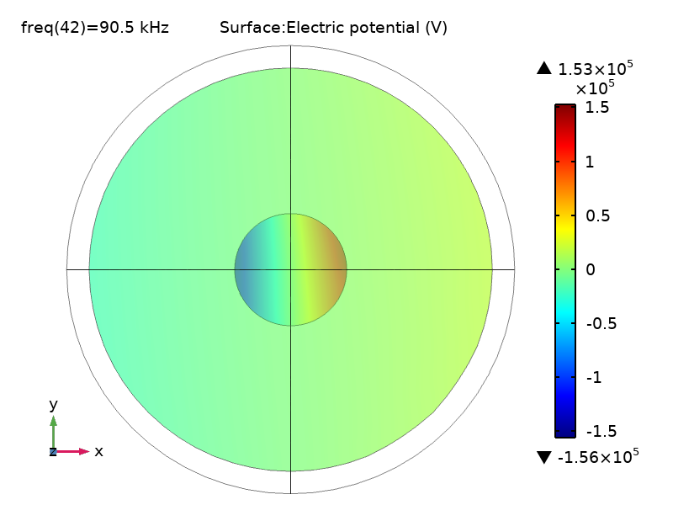
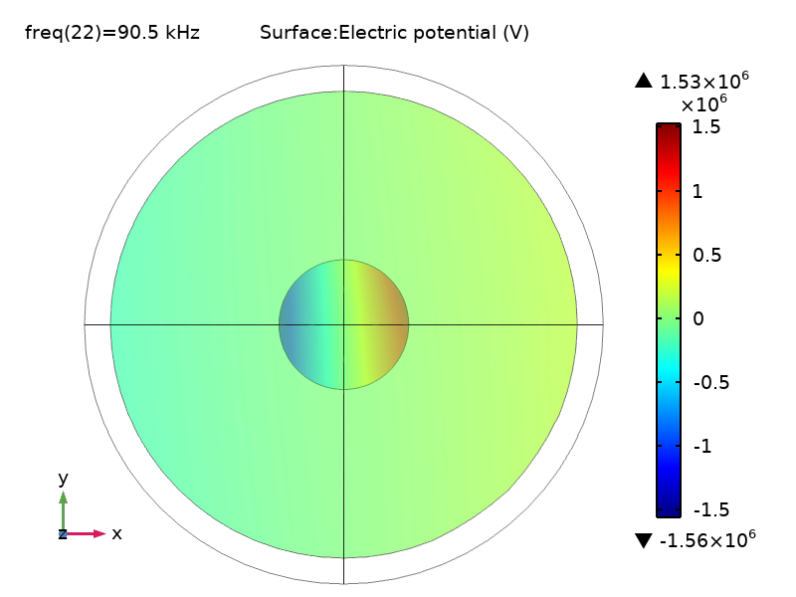
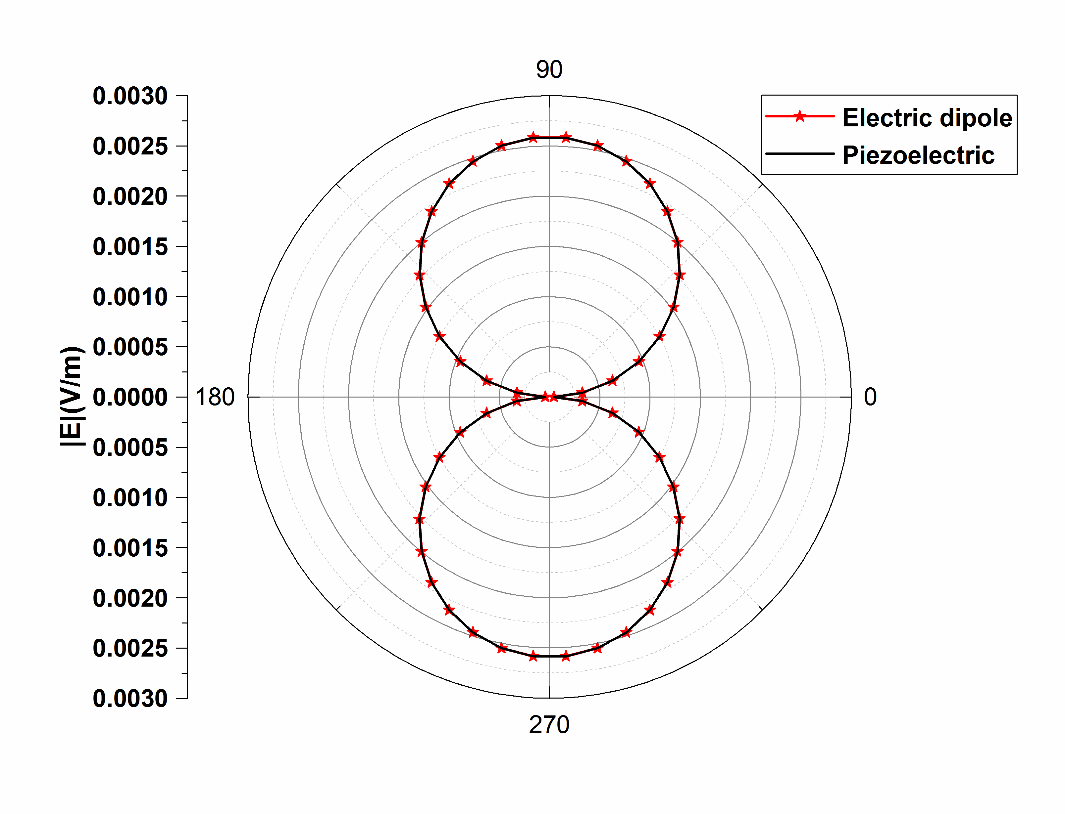
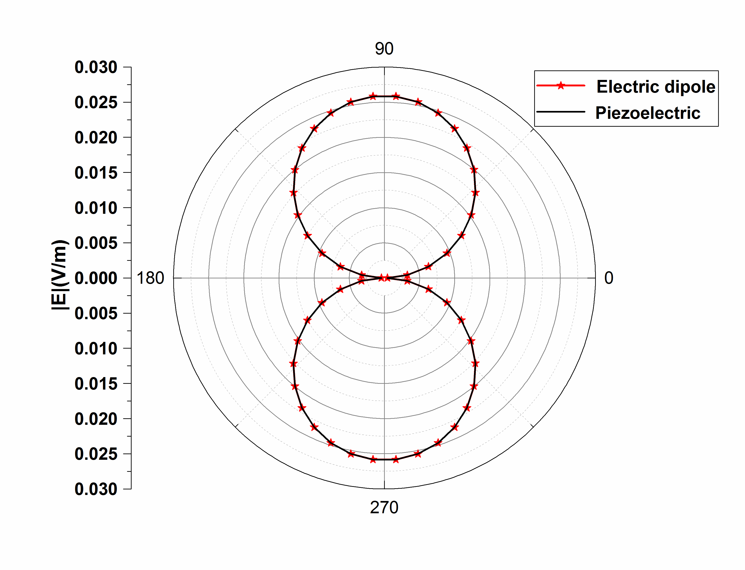
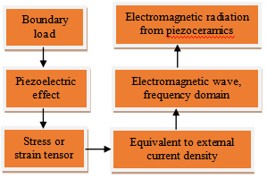
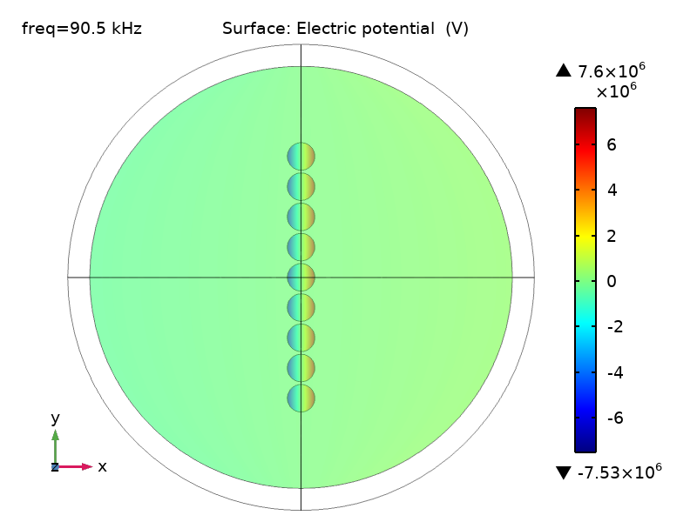
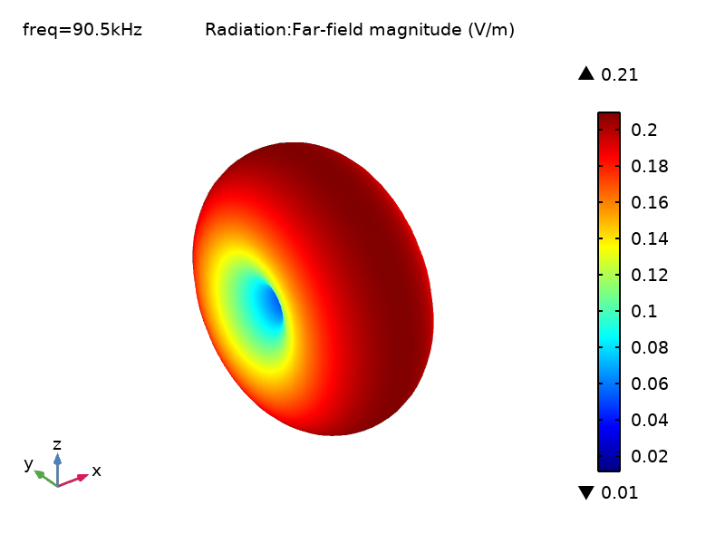
A VLF Resonant Antenna Based on Piezoelectric Ceramics
Xueqin Ma^{1,4}, Huili Zheng^{1,3}
¹National Key Laboratory of Science and Technology on Antennas and Microwave
²School of Electronic Engineering
³Xidian University, Xi’an, Shaanxi 710071 China
⁴Email:1549011861@qq.com
Introduction
A very low frequency (VLF) resonant antenna based on piezoelectric ceramics is proposed in this paper. Combined with Maxwell's equations, electrostatic equations and piezoelectric constitutive equations, COMSOL Multiphysics is used to coupling structural mechanics, electrostatics and electromagnetic waves. A disk resonant antenna with a radius of 50mm, a thickness of 6mm and an operating frequency of 90.5 kHz is designed using piezoelectric ceramics (PZT-5H) as the material. The simulation results show that the radiation characteristics of the antenna become stronger with the increase of the boundary load applied on the upper surface of the piezoelectric disk. The number of parallel antennas will also enhance its radiation characteristics and achieve the matching between the antenna and the feed. In addition, the disk resonant antenna can be equivalent to a dipole antenna. Compared with the electrically small antenna of the same size, it can achieve high efficiency and miniaturization without loading complex matching circuit.
As shown in Fig.3-4, various quantities such as electric potential, displacement, E-plane pattern and velocity differ by an order of magnitude. As shown in Fig.3, the spatial potential distribution calculated by the electrostatic module is symmetrically distributed on the left and right potentials in the x direction with opposite sizes. It is equivalent to an electric dipole in the x direction. Fig. 4 shows that the far-field radiation pattern of the piezoelectric resonant antenna is consistent with that of the dipole antenna.
Fig. 3 The electric potential distribution.
(a)20 MPa
(b)200 MPa
Theory and methods
COMSOL Multiphysics calculates the "piezoelectric effect" using the software integration module -- "solid mechanics" and " electrostatics". These two modules can only calculate the static field and cannot predict the electromagnetic radiation behavior. Therefore, physical fields such as structural mechanics, electrostatic field and electromagnetic wave can be coupled for far-field calculations through equations.The operation process of this study is shown in Fig. 1.
Fig. 1 Flow chart of numerical simulation.
(a)20 MPa
(b)200 MPa
Fig.4 E-plane pattern.
2)Array design
In order to compare the electrical characteristics of the array with that of a single piezoelectric disk, only the number of piezoelectric disks is increased when other conditions are the same. Boundary loads are set at 200 MPa. Electric potential distribution and far-field radiation direction diagram are shown in Fig. 5. It can be seen from Fig.5 that under the same boundary load, the radiation characteristics of the antenna array are three orders of magnitude higher than that of a single resonant antenna. Since the spacing between the disks is much smaller than the wavelength of the electromagnetic wave, the far-field radiation pattern of the resonant antenna array is still the radiation of the electric dipole antenna.
Fig.5 Electric potential and far-field radiation pattern.
Results and analysis
A. Structure of antenna
The outer side of the piezoelectric material is the air domain (free space). The "Perfect Matching Layer (PML)" is used as the absorption boundary in the "Electromagnetic Wave, Frequency Domain" module. Antenna structure is shown in Fig. 2.
Fig. 2 Structure of antenna
B.Simulation results
1)Different boundary loads
In order to study the influencing factors of the antenna field distribution, other conditions remain unchanged. The disk’s bottom surface is fixed while its top surface is oscillated with a shear load of 20 MPa and 200 MPa in the x-direction.
Conclusion
In this paper, the electromechanical coupling method is used to analyze the electromagnetic radiation characteristics of the piezoelectric resonant antenna. With the help of the piezoelectric effect module in COMSOL Multiphysics, the electromagnetic field is coupled in it to realize the multi-physics solution. The far-field characteristics of the proposed model confirm the similarity between the piezoelectric resonant antenna and the electric dipole in the shearing mode. The effects of different boundary loads on the radiation characteristics of the piezoelectric antenna are analyzed. That is, the deflection of the dipole moment in the piezoelectric ceramics depends on the stress applied. In addition, ADS software is used to simulate the BVD circuit model and the equivalent circuit can simulate the impedance change with frequency. In order to prove that the radiation characteristic of antenna array is stronger than that of a single antenna, multi-stage parallel connection is adopted. Finally, a good result is obtained, which provides a good reference for realizing low frequency communication.
Notes:
This poster template is from http://www.swarthmore.edu/NatSci/cpurrin1/posteradvice.htm. It is free, free, free for non-commercial use. But if you really like it, I’m always thrilled to get postcards from wherever you happen to be presenting your poster. Have fun. Sincerely, Colin Purrington, Department of Biology, Swarthmore College, Swarthmore, PA 19081, USA. Email: cpurrin1@swarthmore.edu

