Slide 1
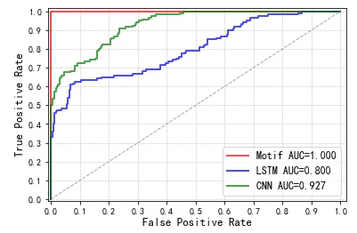
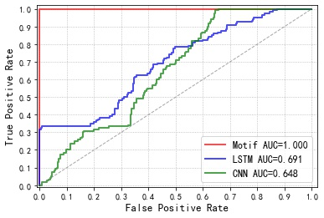
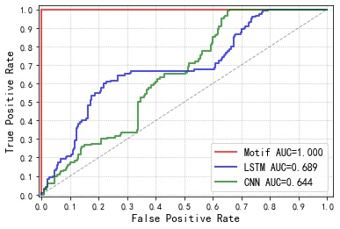
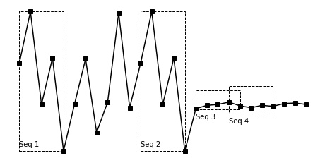


Recognition of MFR Based Motif Discovery
Pengcheng Wang, Weisong Liu, Chao Wang, Pengyu Zhang, Tailai Wen, Zheng Liu*
College of Electronic Science, National University of Defense Technology, Changsha, China, 310014, China
*Corresponding author’s e-mail: liuzheng@nudt.edu.cn
ICEICT2021
XI’ an
Introduction
MFR Recognition
Multi-function radar (MFR) has pulse-level parameter agility, and under the scheduling of complex procedures, it can adjust resource allocation in an optimal way to perform multiple tasks in different directions. The agility of the parameters makes it difficult to describe MFR statistically, and traditional statistical description methods based on signal characteristics are difficult to support the needs of MFR recognition tasks. Another potential MFR description method is using the high-dimensional temporal pattern hidden in pulse stream, which is represented by the pulse repetition interval (PRI) switch rule and value range. This paper uses motif mining algorithm to find high-dimensional repeated patterns in MFR pulse stream, and the key PRI sequence of MFR is obtained through further screening. Then, multiple key sample sequence matchers are integrated into a matching degree generator, which is used to output the matching degree between the MFR to be identified and the reference MFR. Simulation results show that compared with the deep learning method, it has better performance and stronger interpretability.
In addition to the proposed MFR recognition method based on motif discovery and key PRI sequence alignment, we also implement two MFR recognition methods based on deep learning, including LSTM network and CNN network. In the training process of the deep learning method, the PRI sequence corresponding to every 10 pulses of each MFR’s PRI series is divided into a training sample, and the label corresponding to the MFR is attached. Each MFR has 8000 training samples, and the method of 5-fold cross validation is used in the training process to make the variance of the result smaller. In the process of recognition, the model takes 10 PRI values as the step length to read the PRI series to be identified, that is, the recognition result is output once every 10 pulses, and then the model discriminates according to the voting method to determine which MFR the PRI series to be identified belongs to. This voting method is actually to identify MFR in a longer PRI series, which is more robust and can be reasonably compared with the method proposed in this article.
方法
Motif Discovery
Definition 1 (PRI series). The time-of-arrival (TOA) of each pulse is measured, and the differential time of arrival (DTOA) between adjacent pulses are calculated and recorded as PRIs. A PRI series is a finite sequence of real-valued variables, where is the length of the PRI series. The actual PRI series can be very long, but this article is concerned with the subsequences that have the same changing trend and the same value range in PRI series.
Definition 2 (Match). Consider a threshold value and a PRI subsequence starting at position and another PRI subsequence starting at position , the two subsequences have the same length . Then, they are considered to constitute a match if the distance between them is less than the threshold value . The schematic diagram of the PRI series is shown in Fig.1, where the height of the black square represents discrete PRI values, and the connection lines are to emphasize the trend of change. As one can see, seq1 and seq2 constitute a perfect match, and seq3 and seq4 also form a match when the distance threshold is set slightly larger. But what one can observe is that seq3 and seq4 overlap in position. This kind of match does not mean that the pattern represented by seq3 is really repeated twice in the PRI series, so this kind of match is a trivial match. The definition of trivial matching is given below.
Definition 3 (Trivial match and motif). Consider a PRI series of length , containing a subsequence beginning at position and a matching subsequence beginning at , the two subsequences have the same length . is a trivial match to if either or . That is, the match overlapped in position belongs to trivial match. In the actual algorithm, the distance between the subsequences which constitute a trivial match is set to infinity. This paper takes a subsequence pairs which constitute non-trivial match as a motif, and motif mining is to find all non-trivial match in the PRI series.
First of all, it can be observed that under different data quality, the recognition effect of the two methods based on deep learning fluctuates greatly, and the greater the false pulse rate and the missing pulse rate in the training data, the lower the AUC value. This is because deep learning is a data fitting algorithm, and a large amount of noise in the training data will have great impact on the performance of the model. Secondly, in the case of good data quality, as shown in Fig.3, the method based on deep learning also has a relatively good recognition effect, which once again shows that the method based on deep learning relies heavily on data quality. However, in a complex reconnaissance environment, it is very difficult to obtain high-quality data. Finally, it can be observed that the MFR recognition method based on motif discovery which is proposed in this paper achieves the best recognition effect. This is because it accurately finds whether the key PRI sequences of the reference MFR appear in the PRI series. It is a rule and knowledge-driven decision method. Compared with the data-driven method based on deep learning, the method proposed in this paper has stronger interpretability, and has better performance in complex data environment.
Conclusion
Figure 1. PRI series and subsequence match.
Conclusion
We solve the problem of MFR recognition through motif discovery and key PRI sequence matching. The repeated patterns in the reference MFR’s PRI series are effectively mined out and become the key PRI sequences through further screening. The algorithm proposed in this paper is easy to be extended, and new reference MFRs can be added without re-adjusting the model. Simulation results show that the method based on motif discovery has better recognition performance than the popular deep learning method, and it is more interpretable.
2021 IEEE 4th International Conference on Electronic Information and Communication Technology, Xi’an China.
National University of Defense Technology
Changsha, China

