Slide 1
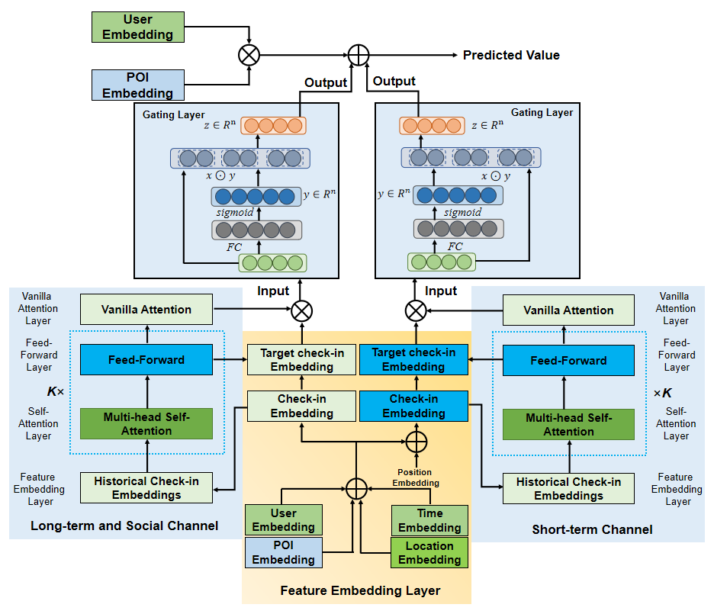
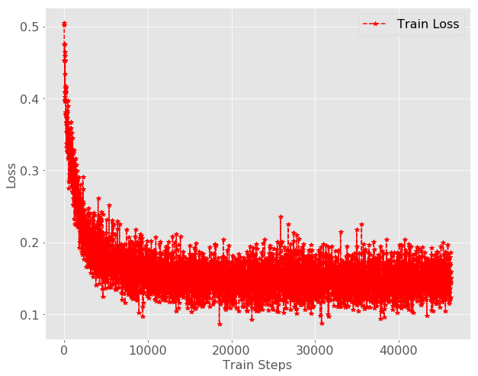
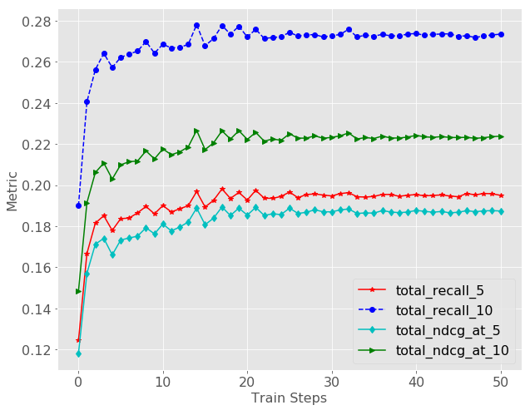
6629 G-DAN-SNR: An improved Personalized POI recommendation algorithm based on gating and attention mechanism
Abstract—In the field of POI recommendation, some scholars proposed the DAN-SNR model, which constructs the deep learning network by self-attention mechanism and designs dual channels to capture users' long and short interest preferences and social influence. Based on the improvement of the DAN-SNR model, the gating mechanism is introduced in this paper based on the self-attentive mechanism before its long- and short-term interest preference features are fused, and the optimal features are filtered by weighting the feature parameters.
Step1. Feature representation layer: Perform feature embedding for user, POI, time, location, and then proceed sum pooling with location embedding
Step2. Feature transformation layer: do feature transformation on the features from the first step using transformer network, extract feature intersection, calculate attention, and finally output the changed features.
Step3. Long-term interest and short-term interest feature representation: do the attention mechanism on the features and target embedding obtained in the second step, and construct long-term interest representation and short-term interest representation, respectively.
Step4. Add gating mechanism to long-term interest and short-term interest: do feature weighting on user personalized recommended POI points and learn a priori structure information of output POI categories.
Step5. Perform sum pooling with user embedding, POI point embedding, and weighted long-term and short-term interest representations to make predictions for the next POI point
Fig. 2. Loss and index convergence curves of G-DAN-SNR
Models | R@5 | NDCG @5 | R@10 | NDCG @10
FPMC-LR | 0.0543 | 0.1133 | 0.1297 | 0.1195
PRME-G | 0.0769 | 0.1276 | 0.1481 | 0.1317
ST-RNN | 0.0904 | 0.1282 | 0.1645 | 0.1648
G RU4Rec+ST | 0.1004 | 0.1431 | 0.1885 | 0.1652
S ASRec+ST | 0.1227 | 0.1502 | 0.1964 | 0.1858
ATST-LSTM | 0.1336 | 0.1537 | 0.1961 | 0.1898
DGRec+ST | 0.1576 | 0.1559 | 0.2214 | 0.2057
D AN-SNR | 0.1832 | 0.1783 | 0.2554 | 0.2219
G-DAN-SNR | 0.1892 | 0.1823 | 0.2644 | 0.2174
The Fig. 1. G-DAN-SNR model architecture
Table 1. G-DA-SNRN baseline model comparison results
Ming Huang, YiJie Fu, Xuan Jiao

