Slide 1
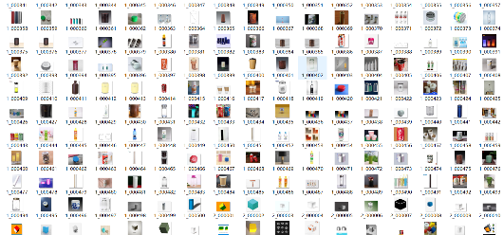
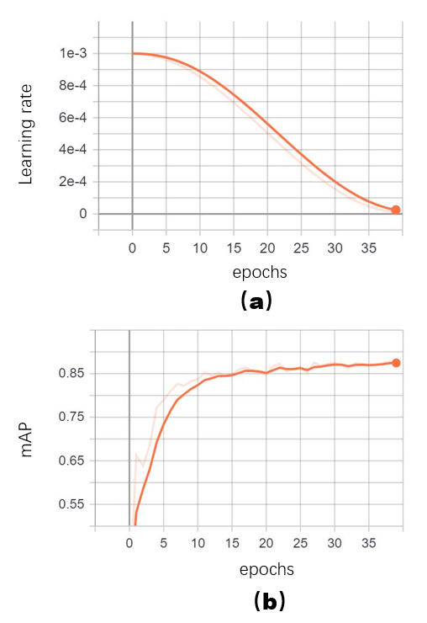
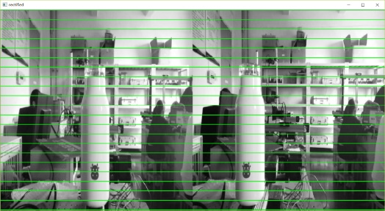
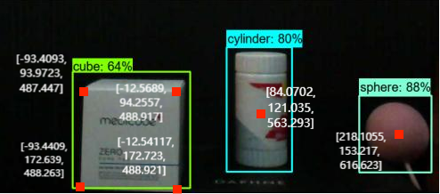
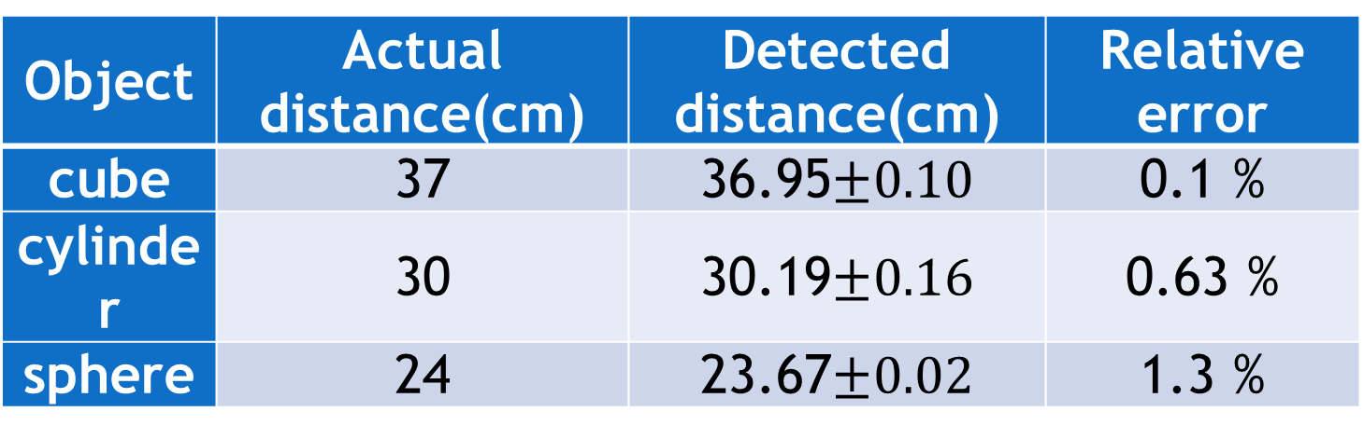
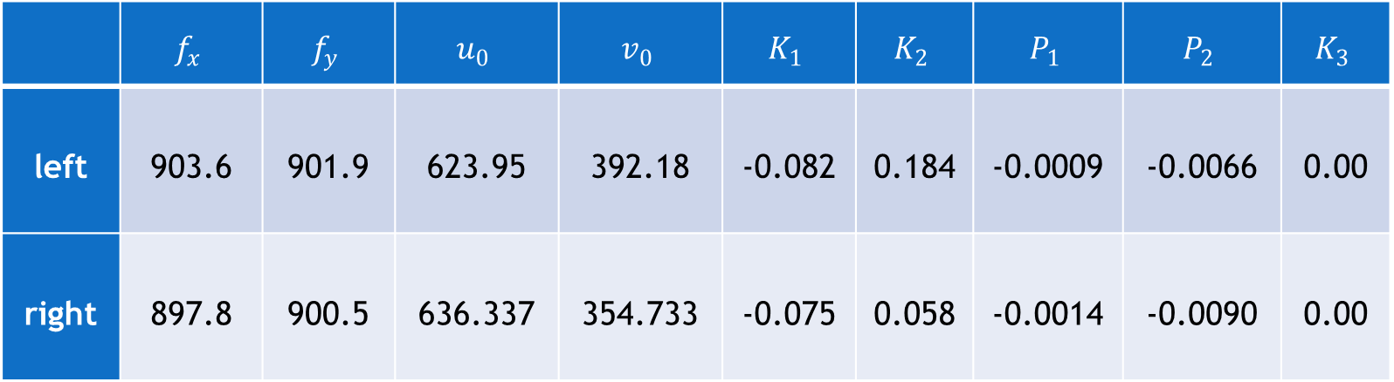
Workpiece intelligent identification and positioning system based on binocular machine vision
Abstract —In this paper, a workpiece detection and positioning system has been studied. Firstly, data sets of workpieces with three different shapes (cube, cylinder and sphere) are established, and the YOLOV3 target detection algorithm is used for deep learning to realize intelligent recognition of different shapes of workpieces. Then by the use of binocular machine vision technology, the key points position of workpieces can be successfully detected with relative error less than 2 %. This workpiece detection and positioning system can be introduced in the mechanical arm grabbing control system to make it has the visual ability similar to human in order to realize mechanical arm intelligent grabbing in complex environment.
1st Yazhuo Li 2nd Mingdie Yan 3rd Xia Liu*
College of intelligent manufacturing, Jianghan University, Wuhan, China, Lemily1113@163.com
1. Object detection based on deep learning technology
In general, the shape of the conventional workpiece is cylinder, square or sphere. In order to realize the intelligent recognition of the workpiece, it is necessary to collect a large number of marked target pictures and establish the image data set of these shapes. As a result, Requests Library in python has been used to crawl through the web to get the pictures. At the same time, in order to enable the trained model more robust, some pictures were taken in some complex environments such as supermarket or other places. There are 871 pictures in the established image data set which including 344 pictures of cylinder, 259 pictures of square and 271 pictures of sphere. The image data set are shown in Fig.1, all images are renamed and resized the maximum side length to 500 pixels.
Fig. 1 Workpiece data set of different shapes.
Fig.2 The training process results by the use of tensorboard. (a) learning rate. (b) mAP IoU=0.5.
In order to visualize the training process, the learning rate, average precision, average recall and Loss in the training are recorded and written into TensorBoard. At the end of each epoch, the mAP is updated to make a judgment and preserve the best weight file. Training process trend charts are shown in Fig. 2. It can be seen that, after 35 epochs, the learning rate reaches 0.00001 and the mAP tends to be stable with value of 0.87. After training process, the optimum weight file is loaded for object prediction.
 | $$f_{x}$$ | $$f_{y}$$ | $$u_{0}$$ | $$v_{0}$$ | $$K_{1}$$ | $$K_{2}$$ | $$P_{1}$$ | $$P_{2}$$ | $$K_{3}$$
left | 903.6 | 901.9 | 623.95 | 392.18 | -0.082 | 0.184 | -0.0009 | -0.0066 | 0.00
right | 897.8 | 900.5 | 636.337 | 354.733 | -0.075 | 0.058 | -0.0014 | -0.0090 | 0.00
2. Binocular vision positioning system
Table I. Internal parameters of camera
After workpiece recognition, it is necessary to locate all the workpieces in the picture. Therefore, a binocular machine vision positioning system is constructed in this paper. As the key sensor of workpiece recognition and positioning, it is very important to select a suitable binocular camera. In order to ensure the detection effect, the camera should meet the requirements of clear imaging and synchronous timing. HNY-CV-001 2560*720 resolution binocular camera from LenaCV machine vision technology Co., Ltd has been used in this paper. The distance between the left and right cameras is 85mm.
A. camera calibration
Distortion coefficient and internal and external parameters of binocular camera can be obtained by camera calibration. "Zhang's Calibration" uses single-plane checkerboard for calibration. As a widely used camera calibration method, its calibration results are highly accurate and effective. The internal and external parameters of the camera were obtained after calibration are shown in Tab. I and Tab. II.
B. Stereo rectification and matching
After getting the R and T matrix of the camera, the stereo rectification should be performed on the two images. Firstly, for the input original image, the distortion coefficient obtained after the camera calibration is used to correct its distortion. Then the image is stereoscopic rectified by rotation matrix and translation vector and cropped. After correction, the imaging planes of the left and right cameras are coplanar, the optical axes of the two cameras are parallel, and the polar lines are aligned. The correction results are shown in Fig. 4.
Table II. External parameters of camera
R | T
 | [ -84.38179 0.03613 -1.9343 ]
3. Workpiece detection and positioning system
The specific steps are as follow. Firstly, a binocular camera is used to shoot the target workpiece, and the YOLOV3 object detection algorithm is used to predict the shape of the target workpiece. Then, stereo correction and stereo matching are carried out by using the calibration results of internal and external parameters of the binocular camera to obtain the parallax map. Finally, according to the shape of the target workpiece, the key points of the target workpiece are determined and the depth information of the key points is obtained. The depth information is transmitted to the control system so as to realize the intelligent grasping of the mechanical arm.
In order to verify the positioning effect of the positioning system, take images of cube, cylinder and sphere as targets for recognition and positioning. Each object is detected 10 times, the results are shown in Table III.
Through the measurement of different targets at different positions, the relative errors are all lower than 2 %. The reasons for the error are the combination of camera fabrication error, camera focal length error, environmental error and position error.
Fig. 4. Stereo rectification results of binocular camera.
Object | Actual distance(cm) | Detected distance(cm) | Relative error
cube | 37 | 36.95$±0.10$ | 0.1 %
cylinder | 30 | 30.19$±0.16$ | 0.63 %
sphere | 24 | 23.67$±0.02$ | 1.3 %
Table III. Positioning error of workpiece detection and positioning system
After evaluation of positioning error, the recognition and positioning system can be used for workpiece detection. In the multi-target detection environment, workpieces with different shape are all in the same image. The system should detect the number and type of workpieces and identify key points of different workpieces by object detection algorithm firstly. Then, the position of key points can be detected by stereo matching. Corner points are the key points of the cube workpiece, and center points are the key points of the cylinder and the sphere workpiece. The detection results are shown in Fig. 5. There are three workpieces of different shapes in the image. By the use of workpiece recognition and positioning system, the numbers and types of workpieces and the position of each workpiece key points have been successfully detected.
Fig. 5 The detection results of workpiece recognition and positioning system

